Slide 1
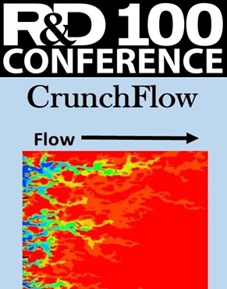
Introduction to Reactive Transport with CrunchTope
Carl Steefel
Christophe Tournassat
Lawrence Berkeley National Laboratory
https://github.com/CISteefel/CrunchTope

Slide 2
Acknowledgments
This work was supported by the Director, Office of Science, Basic Energy Sciences, Chemical Sciences, Geosciences, and Biosciences Division, of the U.S. Department of Energy under Contract No. DE-AC02-05CH11231 to Lawrence Berkeley National Laboratory.
Additional support was provided by the Center for Nanoscale Control of Geologic CO₂, an Energy Frontier Research Center funded by the U.S. Department of Energy, Office of Science, Basic Energy Sciences.
This work was supported as part of the Watershed Function Science Focus Area at Lawrence Berkeley National Laboratory funded by the U.S. Department of Energy, Office of Science, Biological and Environmental Research.

Slide 3
Latest Open Source CrunchTope
https://github.com/CISteefel/CrunchTope
Latest CrunchTope Executables
CrunchTope Release v2.0.1 (April 13, 2022)
https://github.com/CISteefel/CrunchTope/releases/tag/v2.0.1

Slide 4
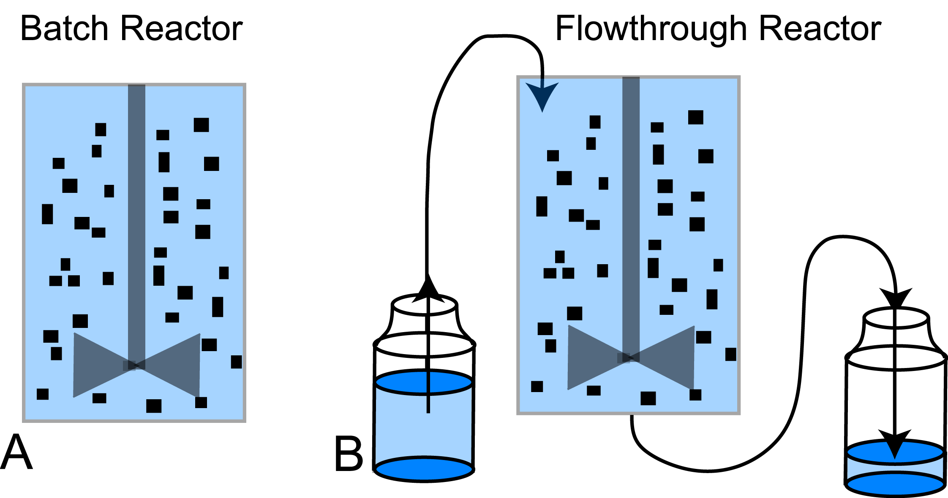
Closed versus Open Systems

Slide 5
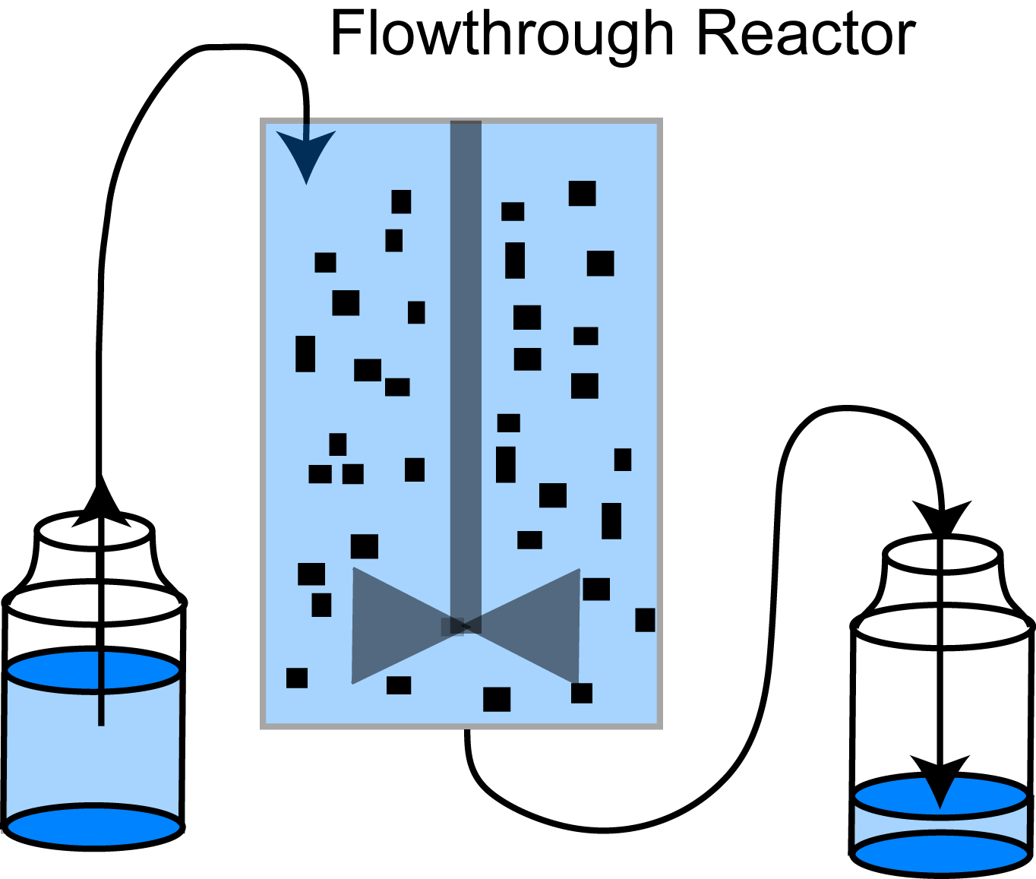
Characteristic Reaction and Transport Times
Conservation Equation
Steady State
Residence Time
t = time
M = mass of solute
Q = volumetric flow rate
V = volume of reactor
C = concentration of solute
R = reaction rate
Ratio of Characteristic Times

Slide 6
Advective Transport
Concentration
Distance

Slide 7
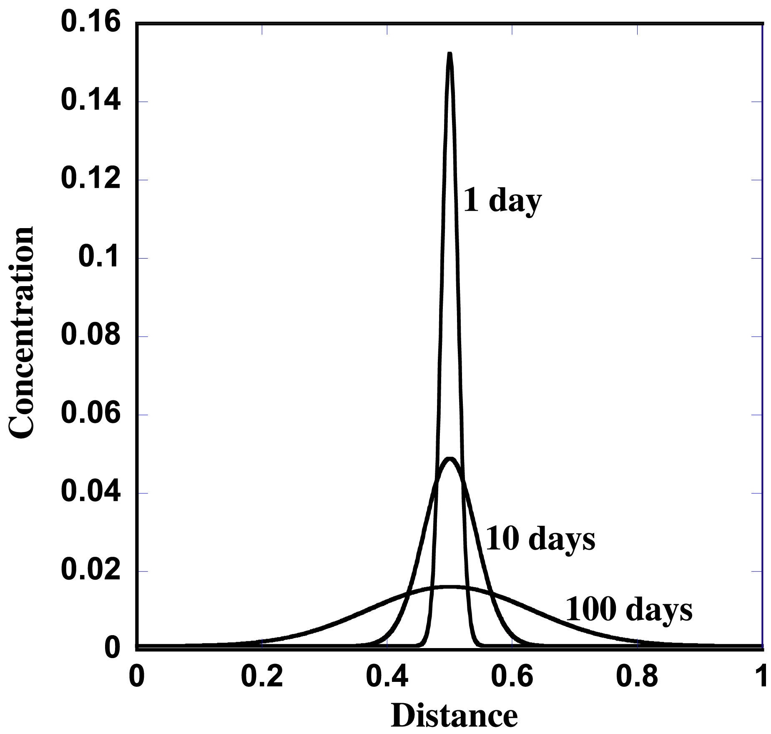
Diffusive Transport
Fick’s 1st Law
Diffusive flux is proportional to the concentration gradient
Fick’s 2nd Law

Slide 8
Hydrodynamic Dispersion
Treatment of dispersive flux as a Fickian process
Dispersion coefficient
Does not capture the time dependence of the dispersion coefficient, which grows as the plume advances
Overestimates mixing and its effect on reactions

Slide 9
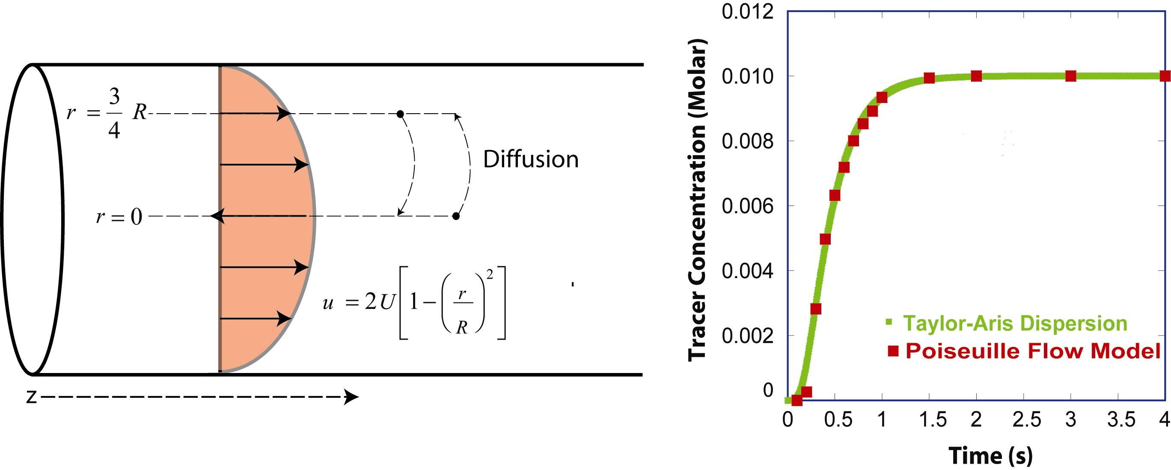
Taylor-Aris Dispersion

Slide 10
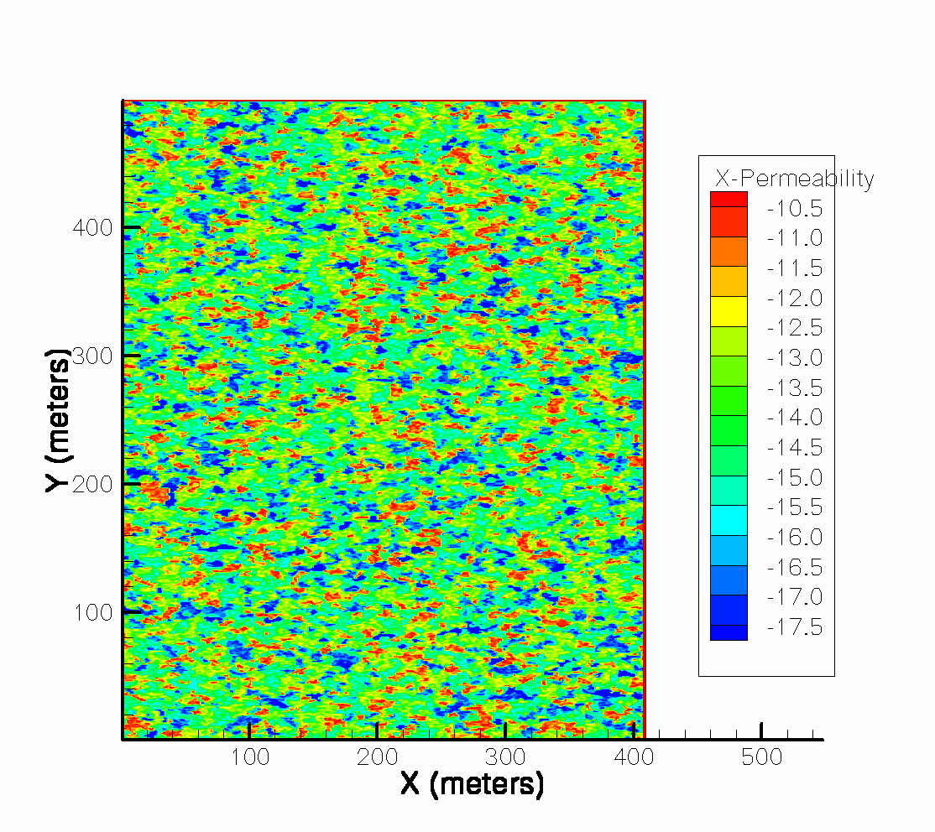
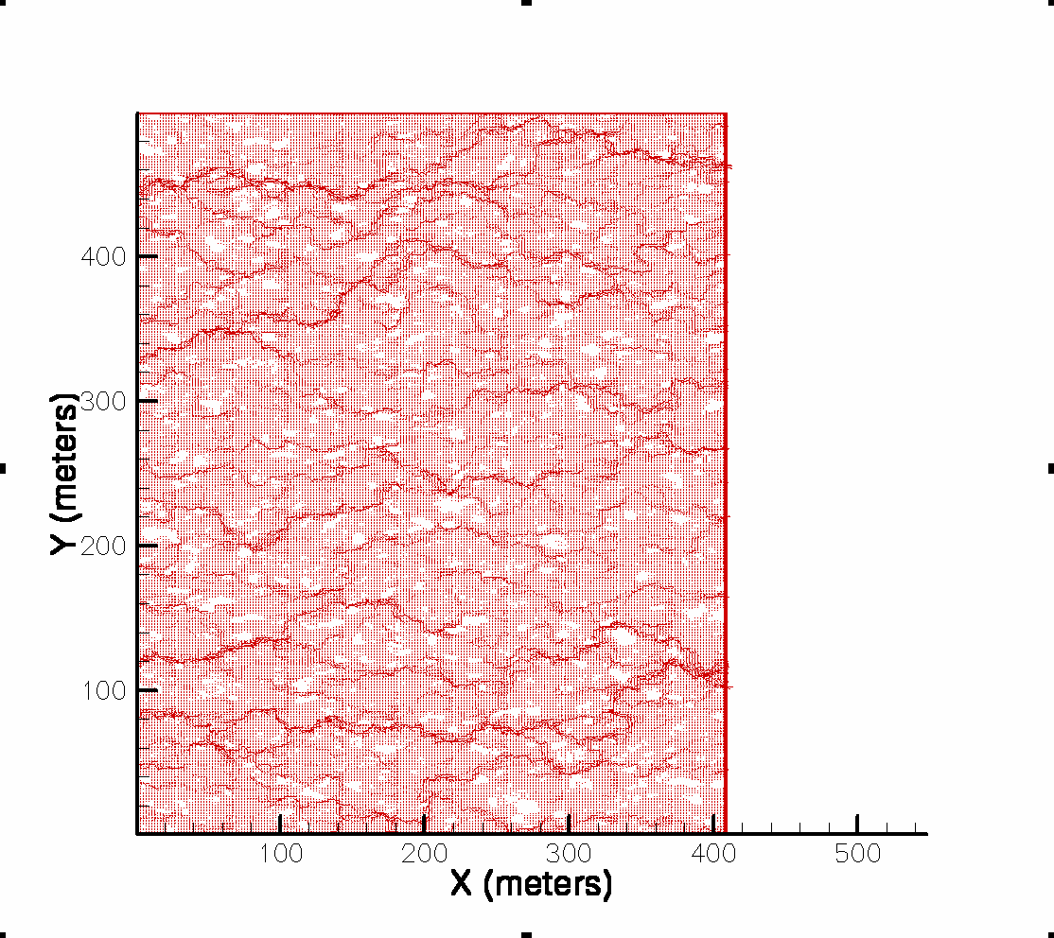
Macrodispersion
Permeability Field
Velocity Field
Flow Direction

Slide 11
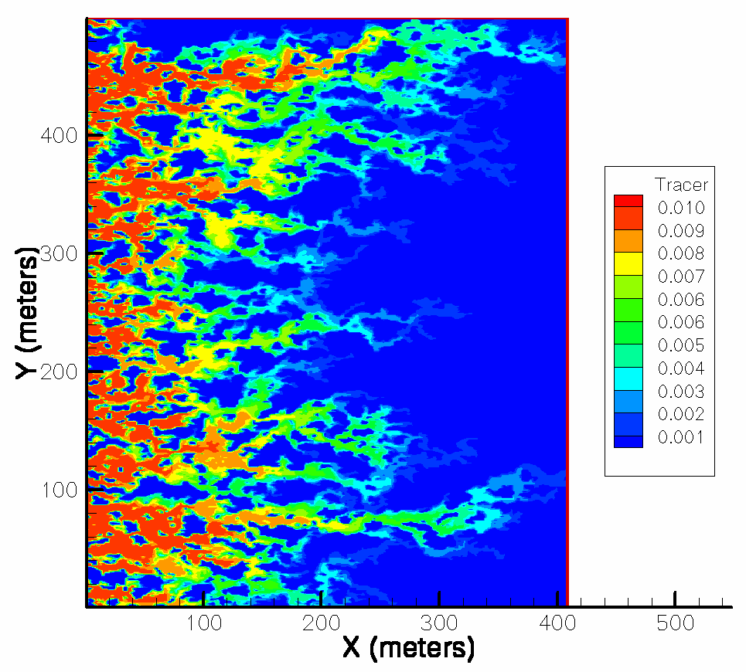
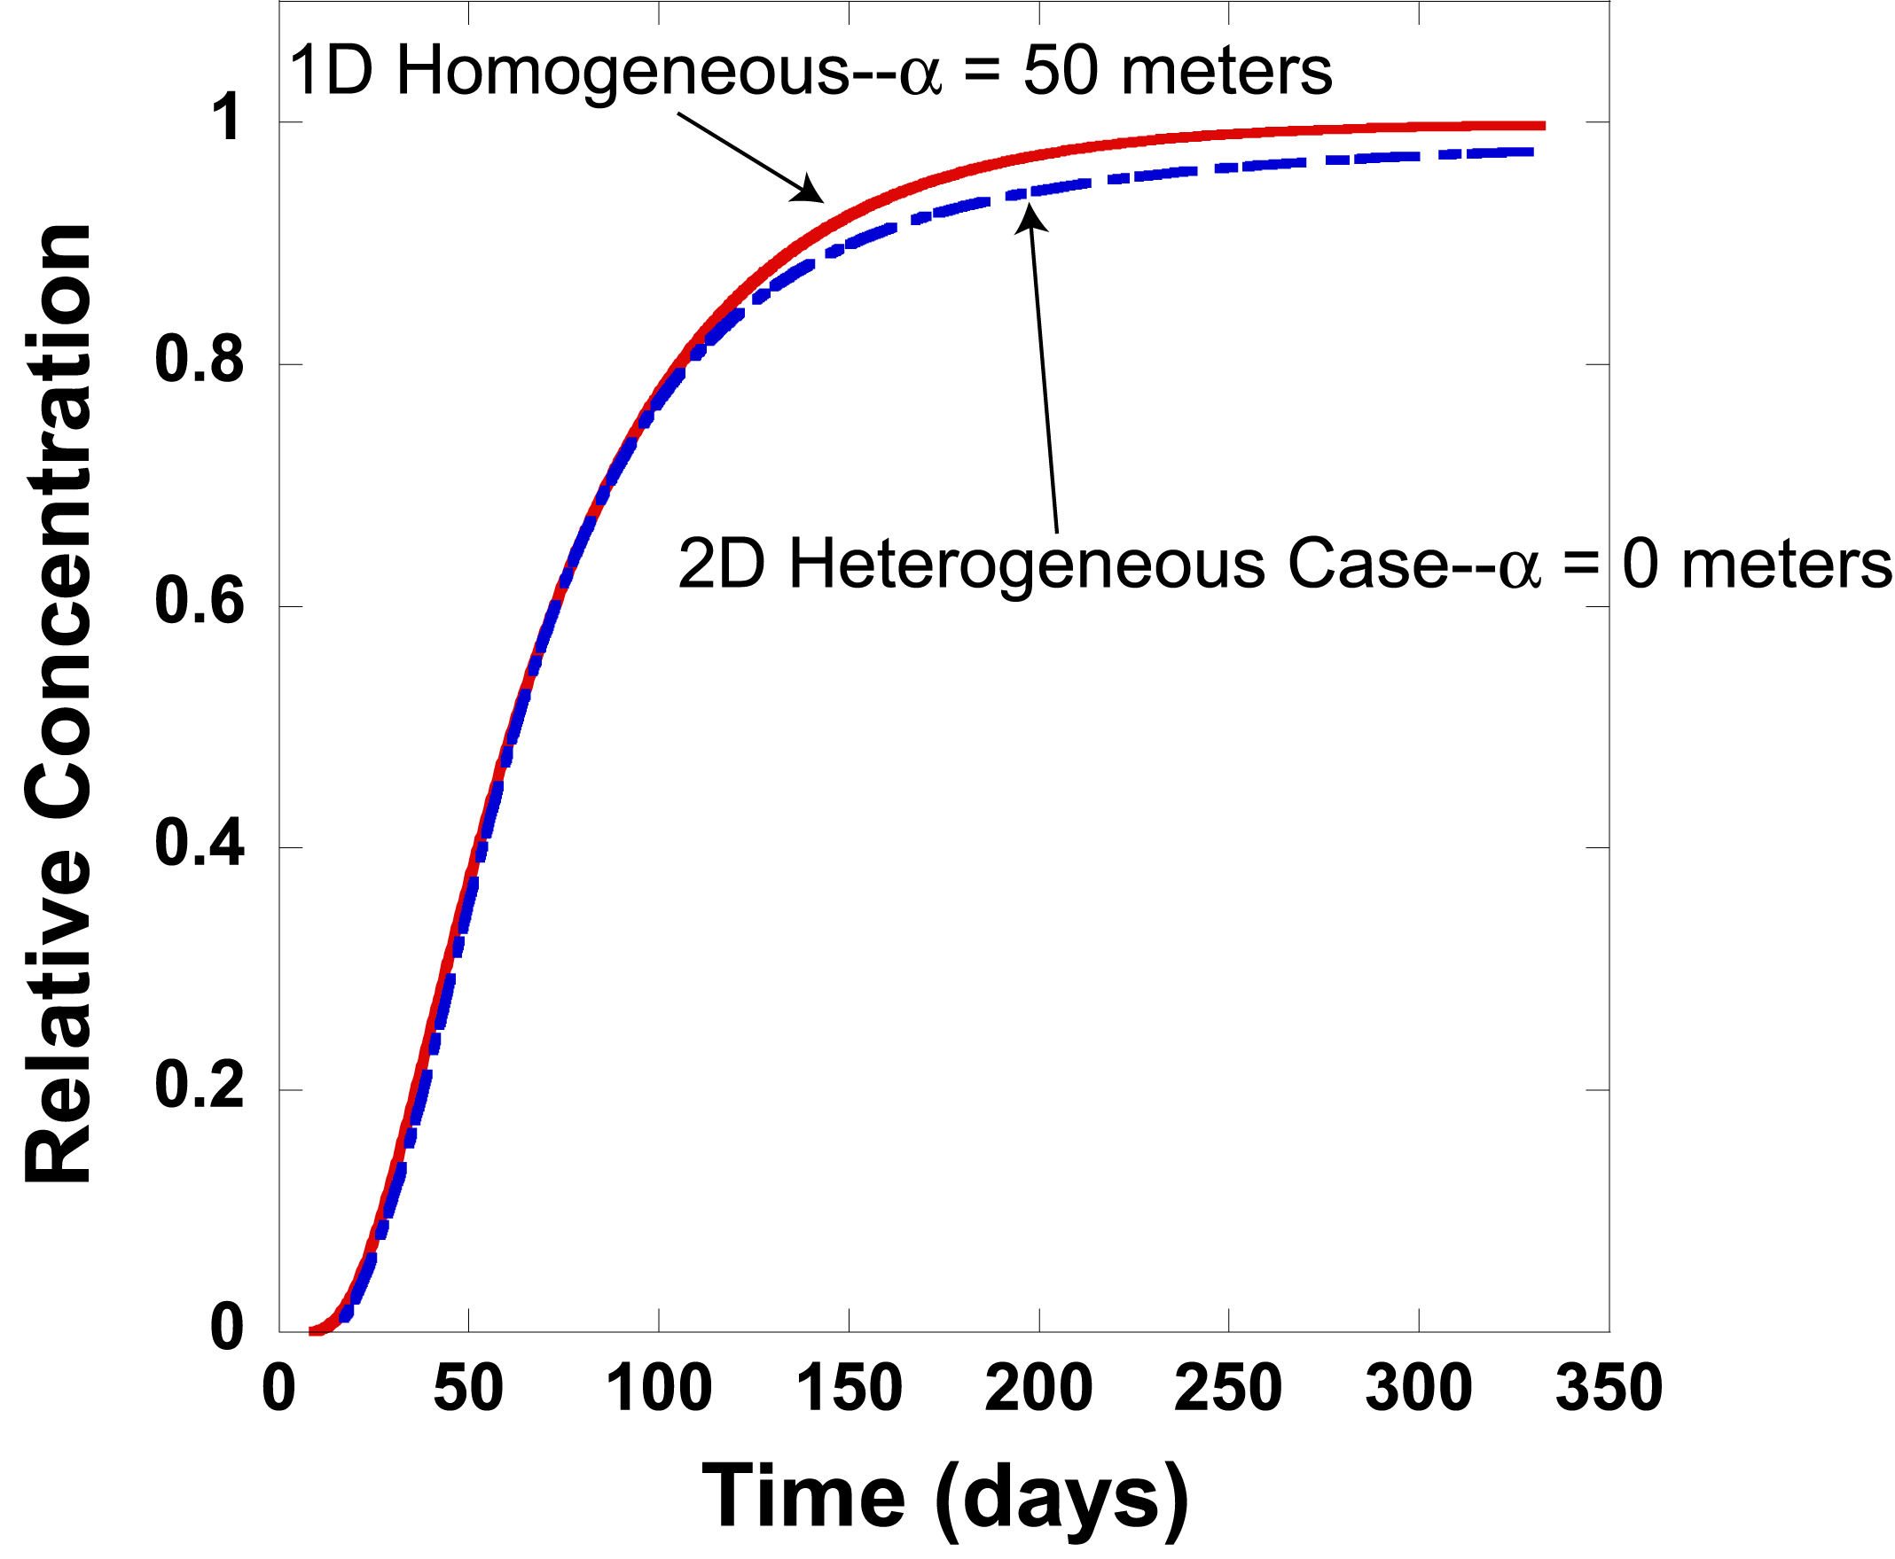
Macrodispersion
Comparison of 2D Heterogeneous Case and 1D Homogeneous Case
Tracer Concentration Field
Capture
Plane
Flow Direction

Slide 12
Non-Dimensional Numbers Péclet and Damköhler
Advection-dispersion-reaction equation
Non-dimensional form of advection-dispersion-reaction equation
Péclet number
Damköhler I number
Damköhler II number

Slide 13
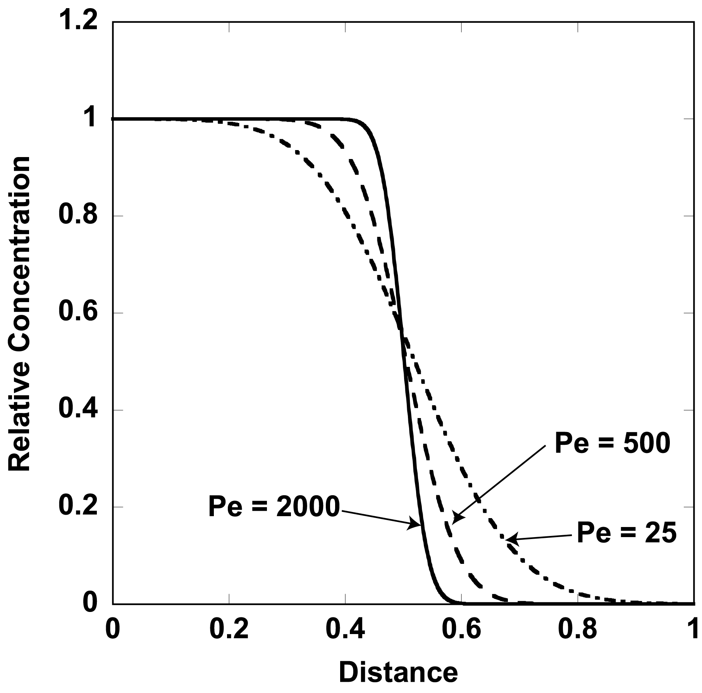
Effect of Peclet Number

Slide 14
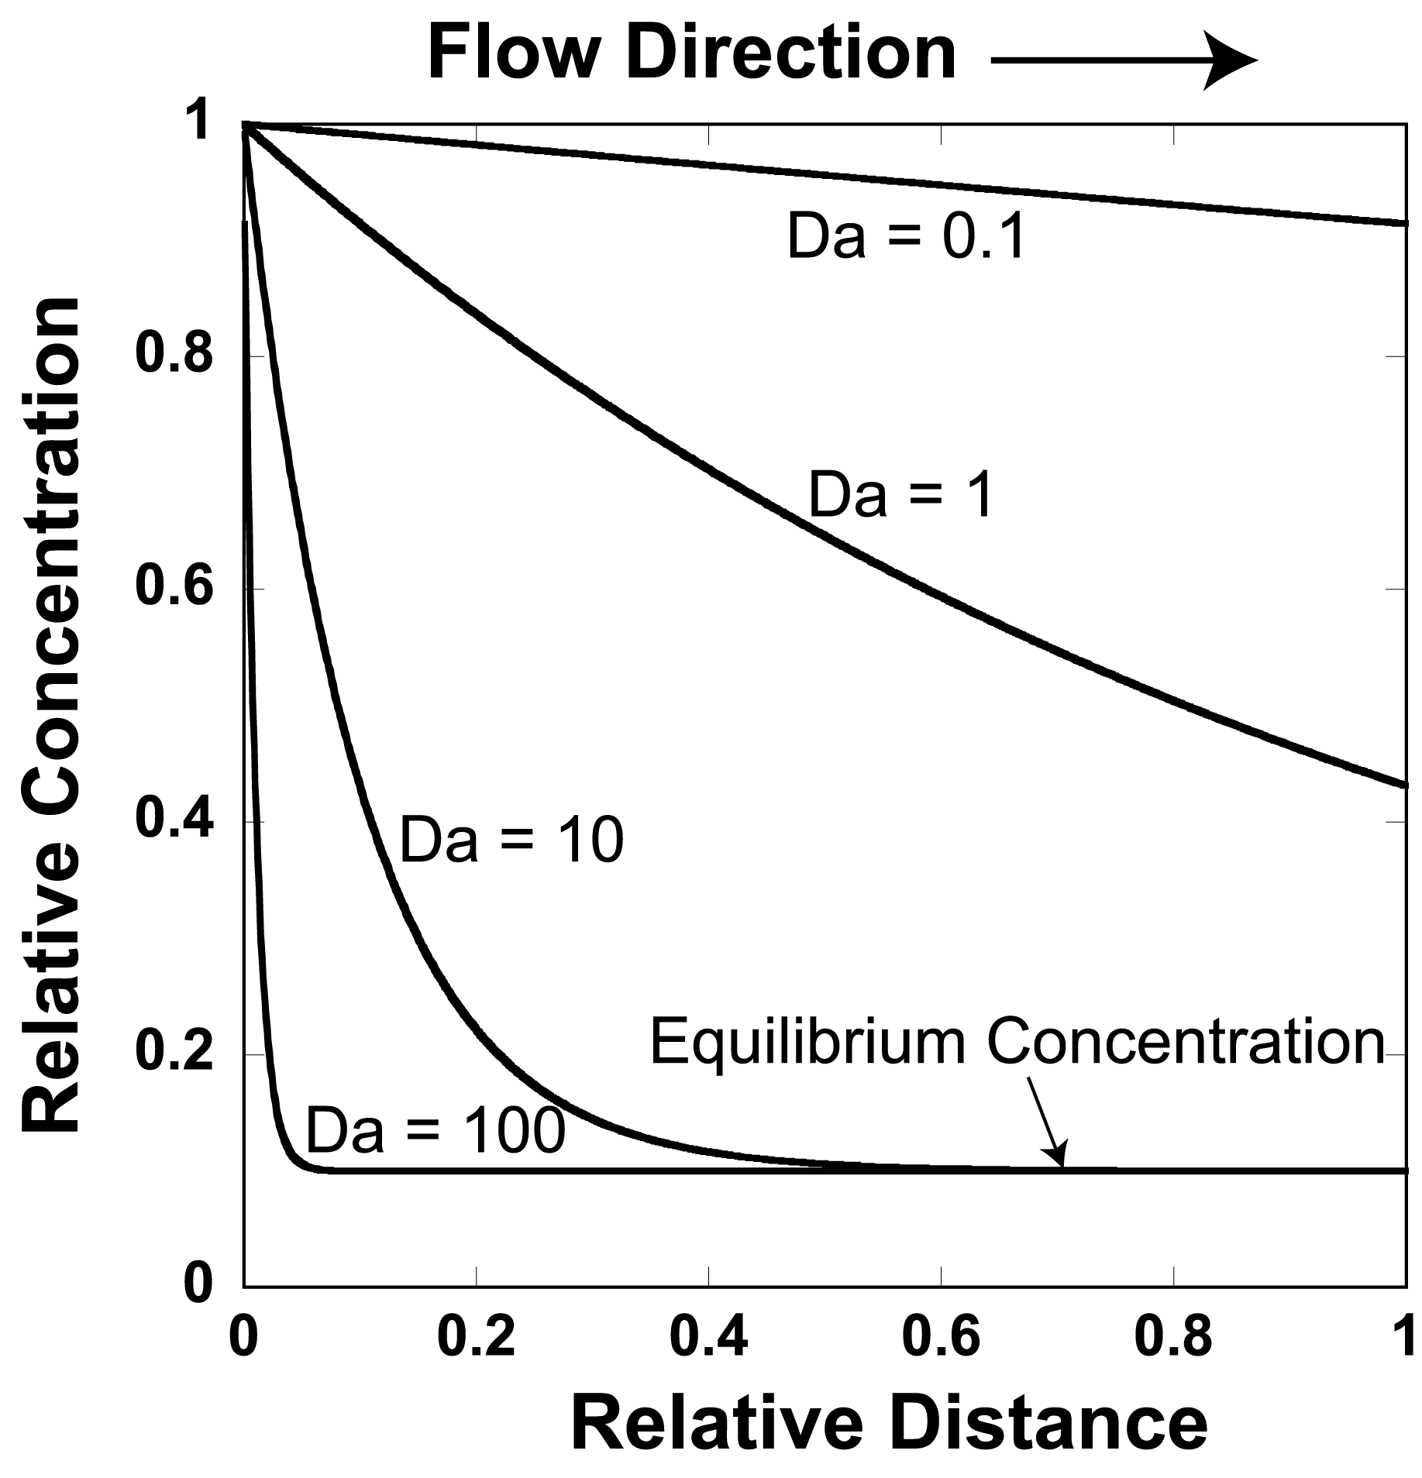
Effect of Damköhler Number

Slide 15
Analytical Solutions to ADR Equation
Solutions in one dimension for linear kinetics take the form
Pure advective transport
Pure diffusive transport
Mixed advective and diffusive transport

Slide 16
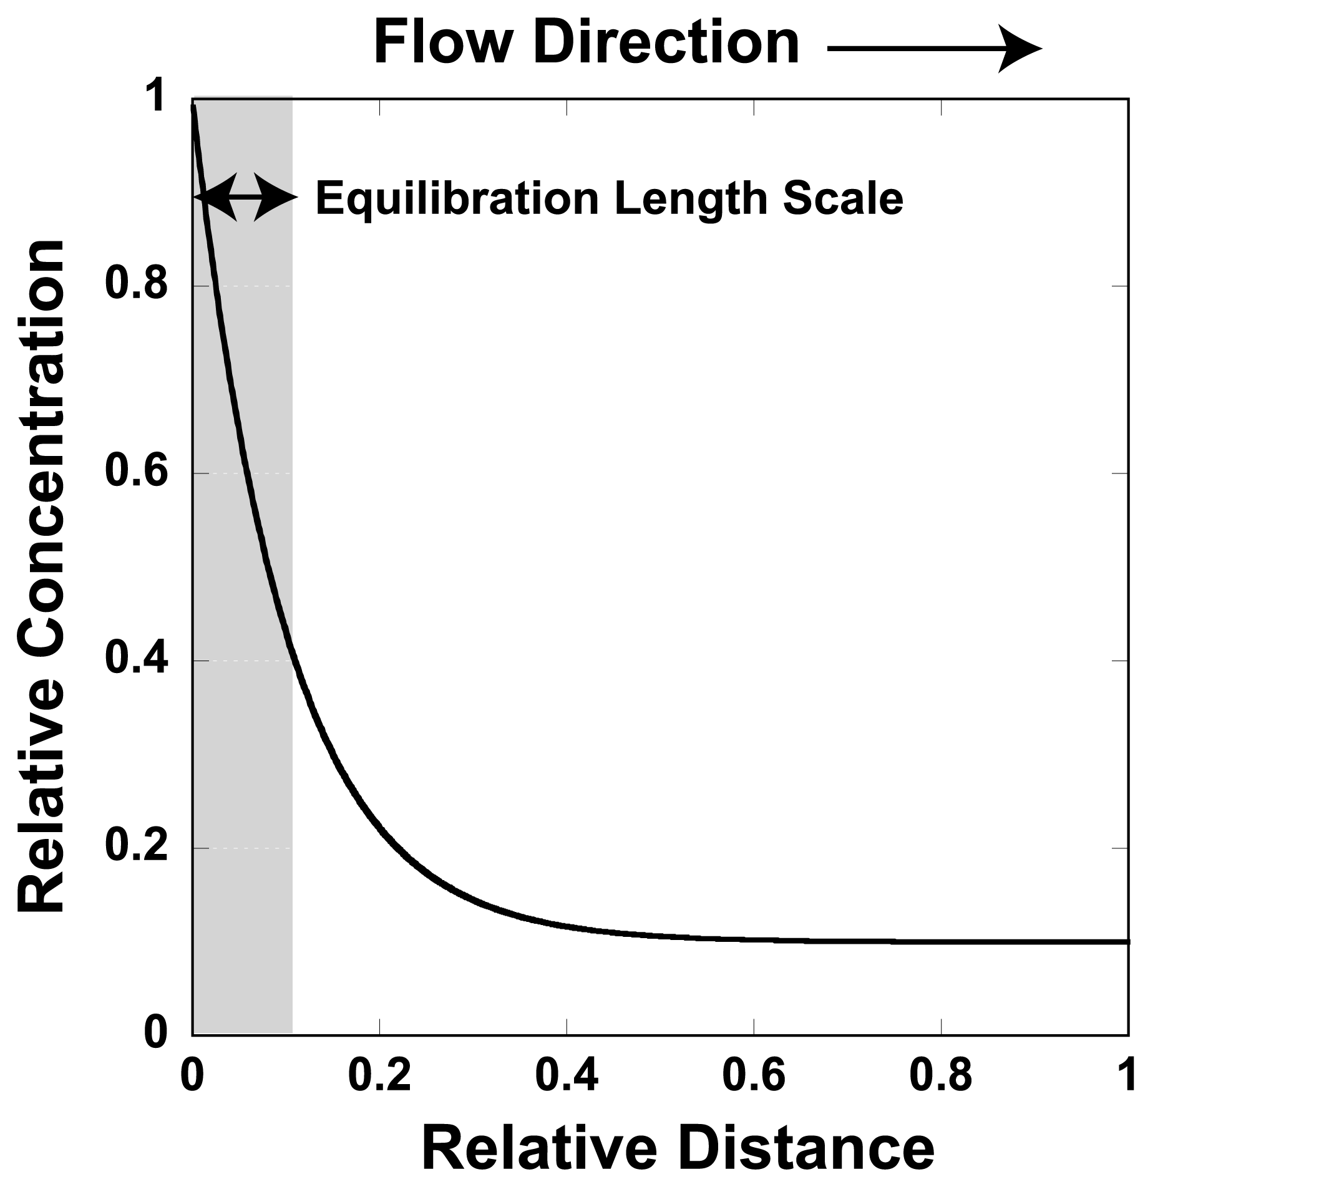
Equilibration Length Scales
Equilibration length = λ

Slide 17
Multicomponent Geochemistry

Slide 18
Aqueous Speciation
Canonical Form
Secondary Species
Primary Species

Slide 19
Total Concentration
Primary Species
Secondary Species

Slide 20
Michaelis-Menten (Monod) Kinetics
Dual Monod
E = electron acceptor
D = electron donor
Inhibition Term

Slide 21
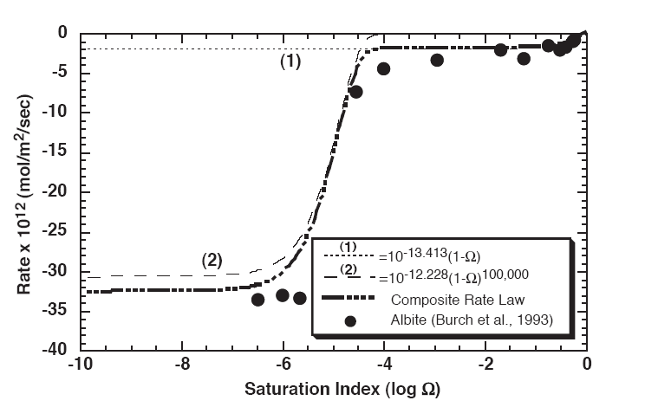
Mineral Dissolution/Precipitation Rate Laws
General Form
Burch et al., 1993

Slide 22
Cation Exchange
Exchange reaction involving Cs⁺ and a competing cation
Gaines-Thomas convention for activity of an exchange species
Moles/g
Cation charge
Selectivity Coefficient
Cation Exchange Capacity
Single exchange site
Multiple exchange sites

Slide 23
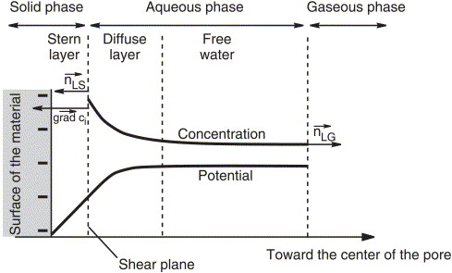
Surface Complexation
Protonation-deprotonation reactions controlling surface charge
First Acidity Constant
Second Acidity Constant
Electrostatic Effects
Surface charge density

Slide 24
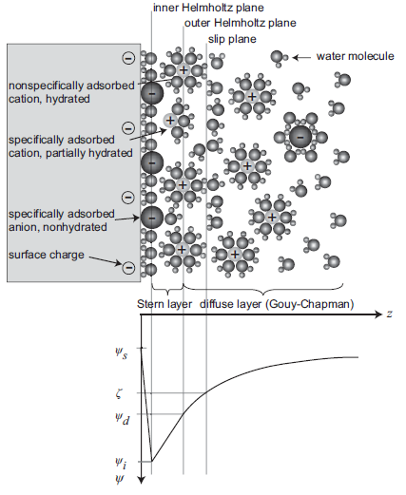
Electrical Double Layer
Double Layers between Charged Surfaces
Solid line: Overlapping double layers
Dashed line: No opposite wall present
After Schoch et al, 2008

Slide 25
Nernst-Planck Equation
Chemical Potential
Electrostatic
Potential
Mobility
Fickian
Diffusion
Electrochemical
Migration
Activity Coefficient
Gradient

Slide 26
Nernst-Planck Equation
Left Boundary
pH 6.0
Cl- 0.1 mM
Na+ 0.1 mM
NO3- 0.001 mM
NOTE: No initial gradient in Na⁺ or Cl⁻, so Fick’s Law would say there is no diffusion
Initial Condition
pH 4.0
Cl- 0.1 mM
Na+ 0.1 mM
NO3- 0.1 mM

Slide 27
Reactive Transport Equations
Fully Kinetic Approach
Accumulation Term
Dispersion-Diffusion
Aqueous Reactions
Mineral Reactions
Gas Reactions
Advection
Partial Equilibrium Approach
Total Concentration
Secondary Species
Rewritten with Primary Species

Slide 28
Reactive Transport Equations: Numerical
Jx-1
Jx
Jx+1
Accumulation Term
Dispersion-Diffusion
Advection
Aqueous Reactions
Rewrite Ψ in terms of primary species concentrations
Accumulation + Reaction Terms
Transport Terms

Slide 29
Short course exercises

Slide 30
Short Course Exercises
Introduction to speciation
Example using the carbonate system featuring various constraints
Stable isotopes of carbon (¹²C and ¹³C) implemented to demonstrate equilibrium fractionation
Advective transport
Introduce a non-reactive tracer into an advective flow field
Investigate numerical dispersion
Diffusive transport
Introduce a non-reactive tracer into a purely diffusive transport problem
No-flux versus Dirichlet boundary conditions
Multicomponent diffusion
Concept of charged species diffusing at different rates and electrochemical migration
Stable isotopes of Cl are implemented to consider the influence of diffusive fractionation
Transverse dispersion
Example based on a recent 2D dispersion experiment, including multi-ion diffusion in an advective flow field
Ion exchange
Introduce ion exchange of cesium in a 1D sediment column with competing Na⁺
Surface complexation
Surface complexation of zinc on iron-hydroxide (PHREEQc example 8)
CO₂ attack on reservoir rocks
Diffusion of gas and flow of water, with variable liquid saturations and multi-mineral nucleation, precipitation, and dissolution
Calcite precipitation with isotopes
Simulation of stable isotope kinetic fractionation of calcium during carbonate precipitation
Two-dimensional flow fields
Xie et al (2015) benchmark on porosity and permeability change due to mineral reaction
Diffusion in clay
Tournassat & Steefel, 2016
Inverse modeling with PEST-CrunchFlow
Steefel et al, 2003

Slide 31
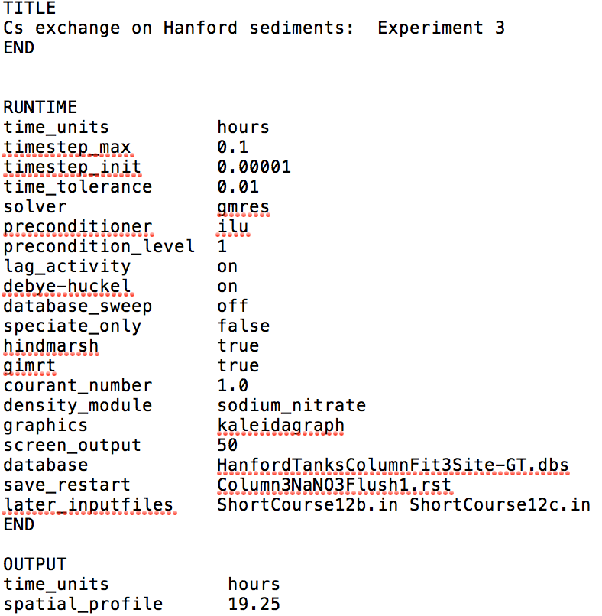
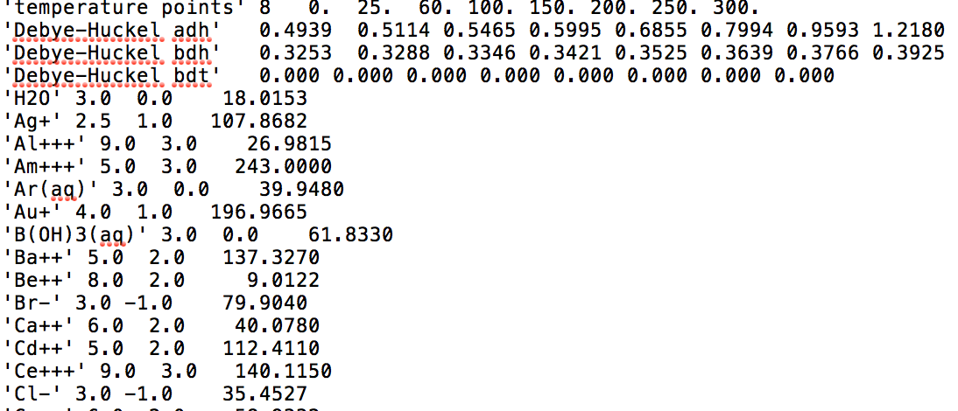
CrunchTope Files
Executable: CrunchTope.exe
Input file: name.in
Database(s): name.dbs

Slide 32
CrunchTope Files
spatial_profile generated automatically at times specified (16, 32 hours)
OUTPUT
time_units hours
spatial_profile 16.0 32.0
time_series Rolle.out 11 20 1
time_series_print K+ Mg++ Cl-
time_series_interval 1
END/
time_series saved every time_series_interval in file Rolle.out
time_series_print writes species specified in file Rolle.out
Spatial profile files include:
totcon#.tec total concentrations in solution
pH#.tec solution pH
conc#.tec log concentrations of individual species
rate#.tec mineral reaction rates (mol/L(bulk)/s)
aq_rate#.tec aqueous reaction rates (mol/L/s)
volume#.tec mineral volume fraction (dimensionless)
porosity#.tec (dimensionless)
velocity#.tec Darcy flux (m³/m²/yr)
toperatio_aq#.out per mil
toperatio_min#.out per mil

Slide 33
SPECIATION

Slide 34
Exercise 1: Carbonate Speciation
Condition: speciate 1
Condition: speciate 2
Condition: speciate 3
Partial pressure CO₂ fixed
Calculate pH for charge balance
Partial pressure CO₂ fixed
Calculate pH for equilibrium with calcite
Partial pressure CO₂ fixed
Calculate pH for alkalinity equivalence point

Slide 35
Input Blocks
SECONDARY_SPECIES
HCO3-
H13CO3-
CaCl+
CaCl2(aq)
CaOH+
HCl(aq)
NaCl(aq)
NaOH(aq)
OH-
CO3—
13CO3--
CaCO3(aq)
Ca13CO3(aq)
CaHCO3+
CaH13CO3+
NaCO3-
Na13CO3-
NaHCO3(aq)
NaH13CO3(aq)
END
RUNTIME
speciate_only true
database_sweep false
database datacom_13C.dbs
graphics tecplot
density_module temperature
END
PRIMARY_SPECIES
H+
CO2(aq)
13CO2(aq)
Ca++
Na+
Cl-
END
Log rate (mol/m²/s)
GASES
CO2(g)
13CO2(g)
END
MINERALS
Calcite -label default -rate -11.00
END

Slide 36
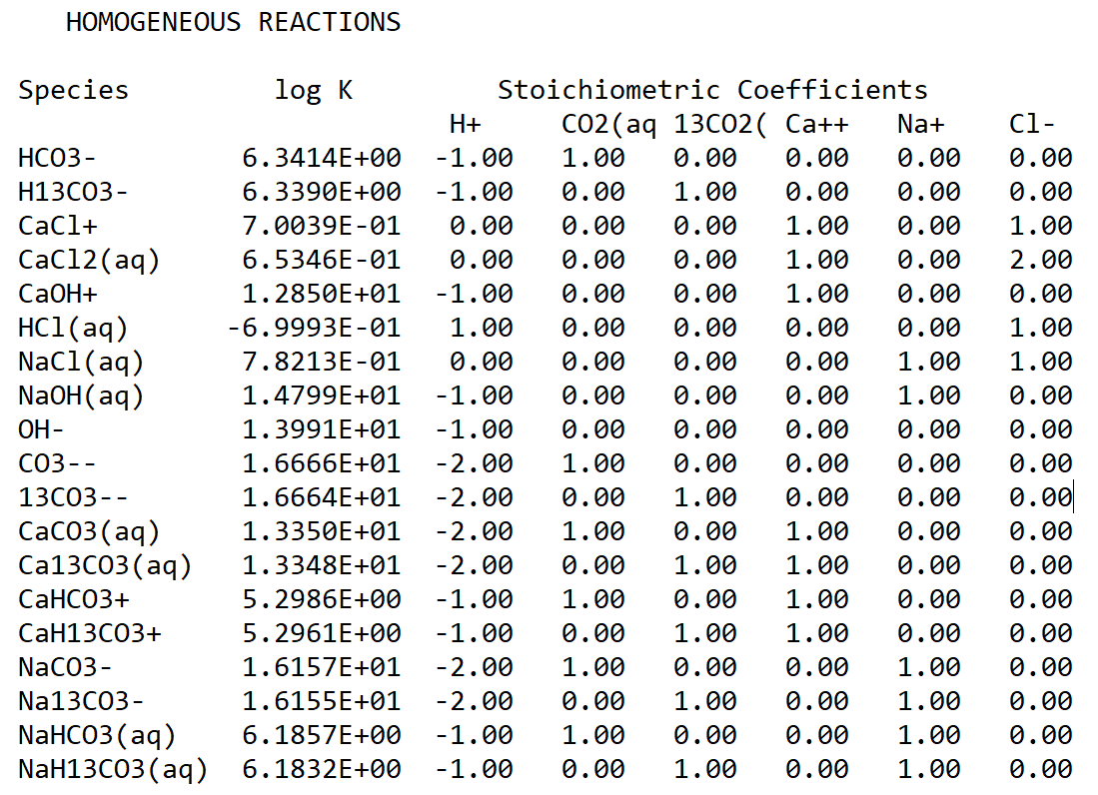
Stoichiometric Reaction Matrix

Slide 37
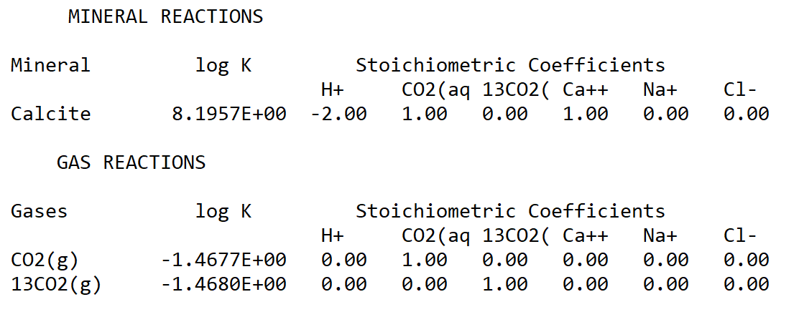
Stoichiometric Reaction Matrix

Slide 38
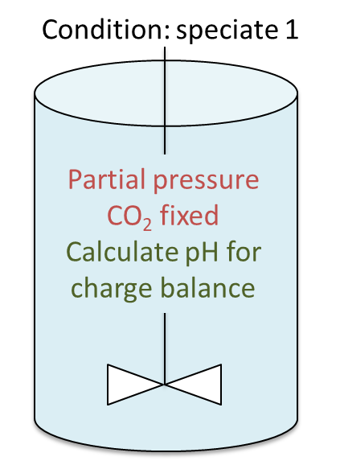
Condition Blocks
Label for condition used in INITIAL_CONDITIONS and BOUNDARY_CONDITIONS and PUMP
Condition speciate1
!! Fix pCO2 and calculate pH based on charge balance
units mol/kg
temperature 25.0
pH charge
!!gas partial pressure in bars
CO2(aq) CO2(g) 3.12E-04
13CO2(aq) 13CO2(g) 3.15E-06
Na+ 0.01
Cl- 0.01
Ca++ 0.00
END
Gas partial pressure in bars

Slide 39
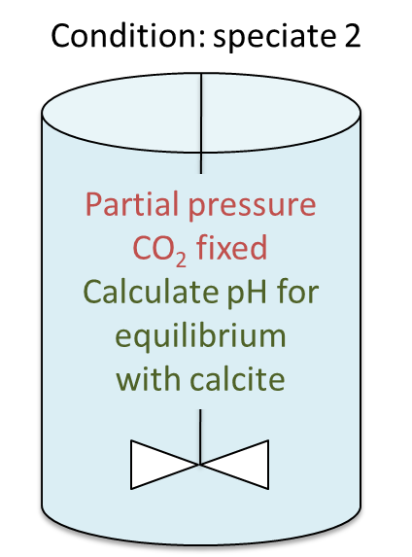
Condition Blocks
Condition speciate2
!! Fix pCO2 and calculate pH based on calcite equilibrium
units mol/kg
temperature 25.0
pH Calcite
!! Gas partial pressure in bars
CO2(aq) CO2(g) 3.12E-04
13CO2(aq) 13CO2(g) 3.15E-06
Na+ 0.01
Cl- charge
Ca++ 0.01
END

Slide 40
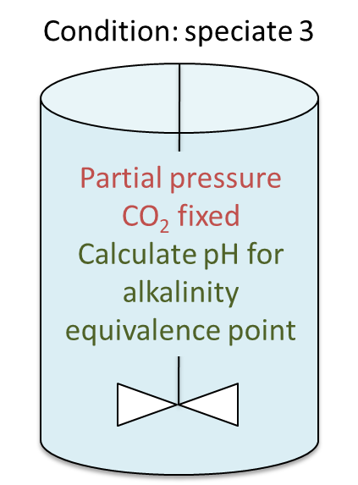
Condition Blocks
Condition speciate3
!! Fix pCO2 and calculate pH based on alkalinity at the CO2
!! equivalence point (alkalinity = 0.00)
units mol/kg
temperature 25.0
H+ 0.00
!! gas partial pressure in bars
CO2(aq) CO2(g) 3.12E-04
13CO2(aq) 13CO2(g) 3.15E-06
Na+ 0.01
Cl- 0.01
Ca++ 0.00
END
Total Hydrogen = -Alkalinity

Slide 41
Discretization and
Initial and Boundary Conditions
DISCRETIZATION
xzones 1 1.0
END
INITIAL_CONDITIONS
speciate1 1-1
END
NOTE: No boundary conditions needed for initial value problem
Minimum 3 grid cells required for a boundary value problem (with transport

Slide 42
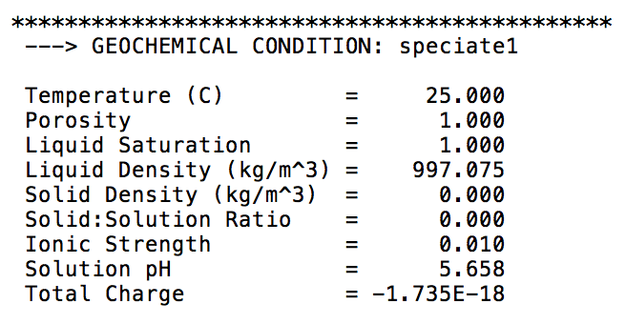
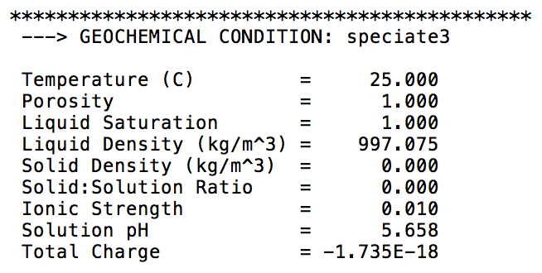
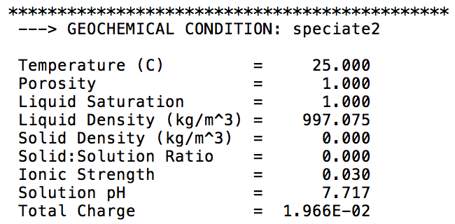
Exercise 1: Carbonate Speciation
View results in ShortCourse1.out

Slide 43
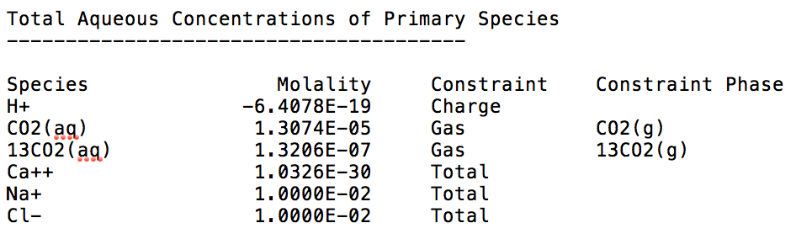
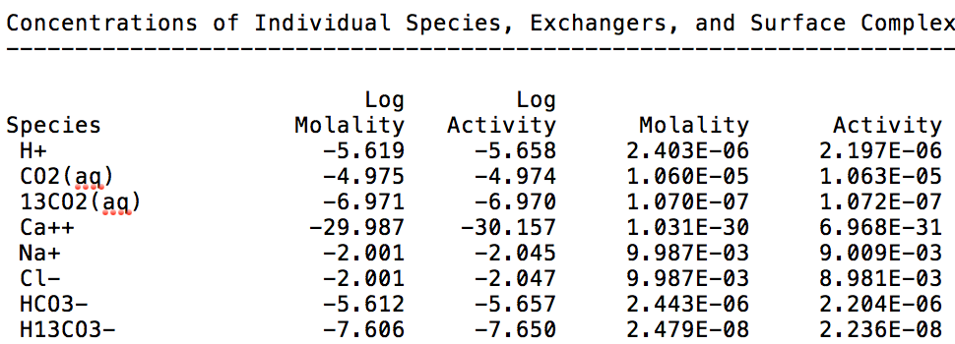
Exercise 1: Carbonate Speciation with Isotopes
View results in ShortCourse1.out
δ¹³C = 0‰
δ¹³C = 4.6‰

Slide 44
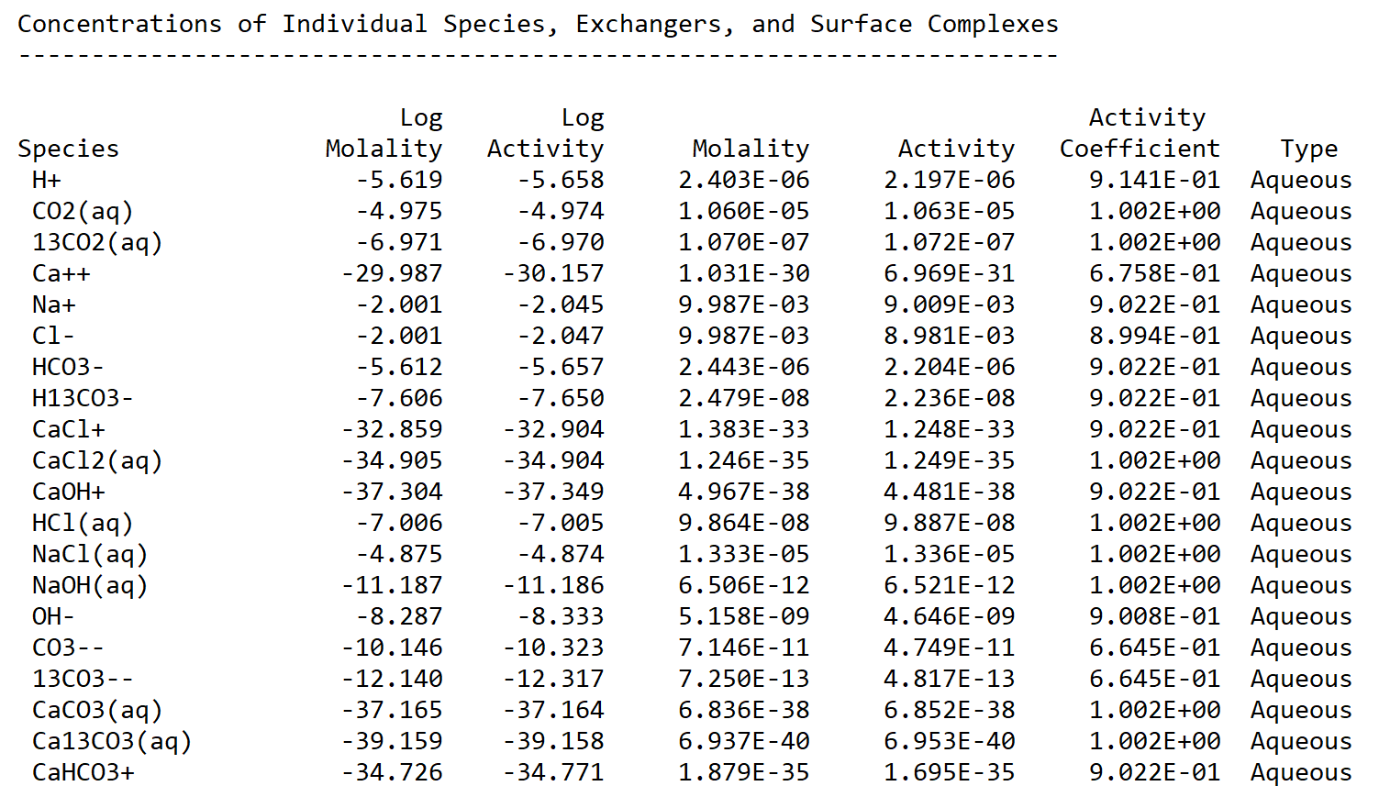
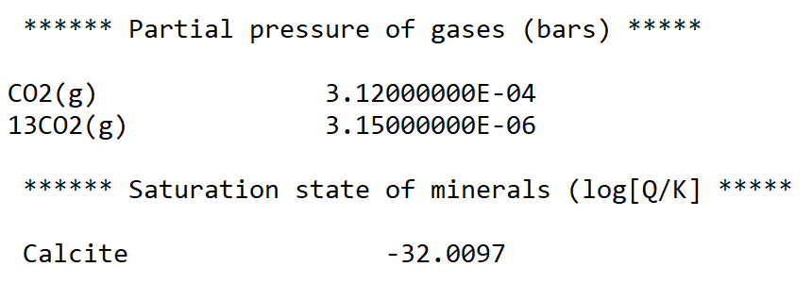
Speciation in ShortCourse1.out
From Speciate1

Slide 45
ADVECTION

Slide 46
Exercise 2: Advective Transport
For constant velocity and 1D
L
concentration
x = vt
J_{x}
Δx
distance
Initial condition: junk2
Left boundary: junk1 flux
Right boundary: junk2 flux
Courant-Friedrichs-Lewy Condition

Slide 47
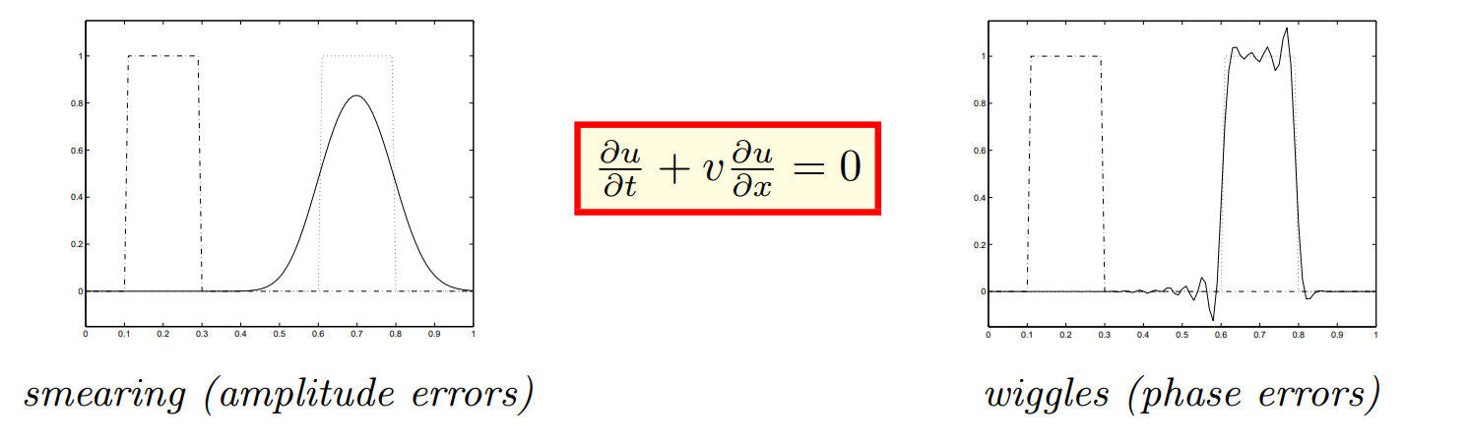
Numerical Dispersion
Upwind Scheme
Taylor Series Expansions
Even terms result in smearing and amplitude errors
Odd terms result in oscillatory phase errors
http://www.mathematik.uni-dortmund.de/~kuzmin/cfdintro/lecture10.pdf

Slide 48
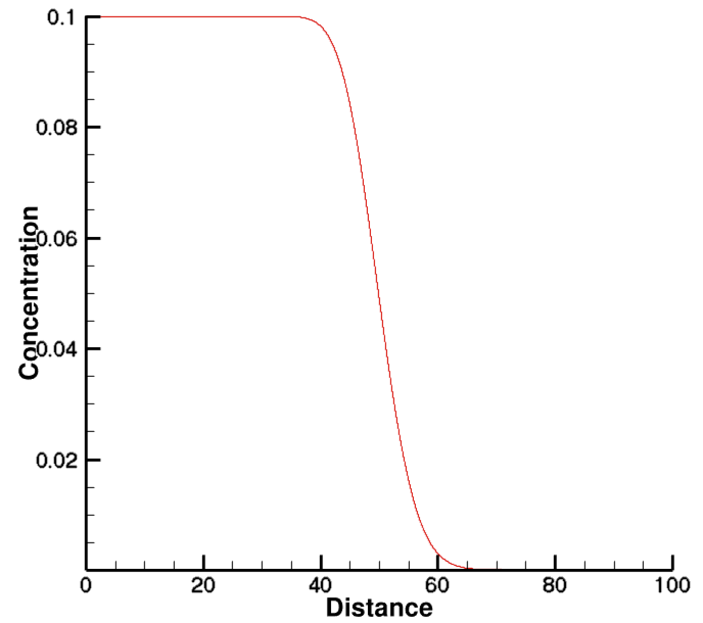
Numerical Dispersion
Exact Solution (Square Wave)
Numerical dispersion
Upwind Finite Difference

Slide 49
Exercise 2 Procedure
Run CrunchTope in “GIMRT” mode, which uses 1st order upwind that introduces numerical dispersion
BOUNDARY_CONDITIONS
x_begin junk1 flux
x_end junk2 flux
END
INITIAL_CONDITIONS
junk2 1-100 1-1 1-1
END
DISCRETIZATION
distance_units meters
xzones 100 1.00
END
Condition junk1
units mol/kg
temperature 25.0
Tracer 0.1
END
Condition junk2
units mol/kg
temperature 25.0
Tracer 0.000001
END
RUNTIME
time_units years
timestep_max 0.010
timestep_init 0.010
time_tolerance 0.1
hindmarsh true
master Tracer
database_sweep no
speciate_only false
gimrt true
database datacom.dbs
END
FLOW
time_units years
distance_units meters
constant_flow 1.0
END
Boundary Condition
TRANSPORT
distance_units meters
time_units years
fix_diffusion 0.0
dispersivity 0.0
END
Initial Condition

Slide 50
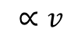
Exercise 2 Procedure
Run CrunchTope in “GIMRT” mode, which uses 1st order upwind that introduces numerical dispersion
Save “totcon1.out” as “totcon1_gimrt.out” to avoid being written over
Change to “gimrt false” so as to use TVD 3rd order accurate scheme with van Leer limiters
Rerun and compare “totcon1_gimrt.out” with “totcon1.out”
Now gradually increase dispersion in the input file (while still using OS3D mode (“gimrt false”) until you get a match between TVD (OS3D) profile and Upwind (GIMRT) profile
RUNTIME
time_units years
timestep_max 0.010
timestep_init 0.010
time_tolerance 0.1
hindmarsh true
master Tracer
database_sweep no
speciate_only false
gimrt false
database datacom.dbs
END
TRANSPORT
distance_units meters
time_units years
fix_diffusion 0.0
dispersivity 0.01
END
$$∝v$$
Units of meters
Turns off upwinding, turns on higher order TVD scheme
Gradually increase until you have a match
What dispersivity do you need to match?

Slide 51
FICKIAN DIFFUSION

Slide 52
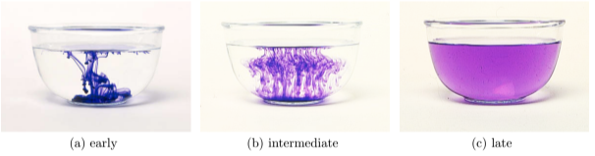
Exercise 3: Fickian Diffusion
Initial Condition
concentration
distance

Slide 53
Exercise 3: Fickian Diffusion
FLOW
time_units years
distance_units meters
constant_flow 0.0
END
TRANSPORT
distance_units meters
time_units second
fix_diffusion 1.E-09
dispersivity 0.0
END
DISCRETIZATION
xzones 501 0.0002
END
INITIAL_CONDITIONS
junk 1-501 1-1 1-1
boundary 251-251 1-1 1-1
END
Condition boundary
units mol/kg
temperature 25.0
Tracer 0.1
END
Condition junk
units mol/kg
temperature 25.0
Tracer 0.0001
END
Writes over earlier specified initial condition
BOUNDARY_CONDITIONS
x_begin junk flux
x_end junk flux
END
After running “flux” BC, switch to “Dirichlet” (fixed concentration) and compare results
“flux” uses flow rate through boundary, if flow rate = 0, then it becomes a No Flux BC
BOUNDARY_CONDITIONS
x_begin junk Dirichlet
x_end junk Dirichlet
END

Slide 54
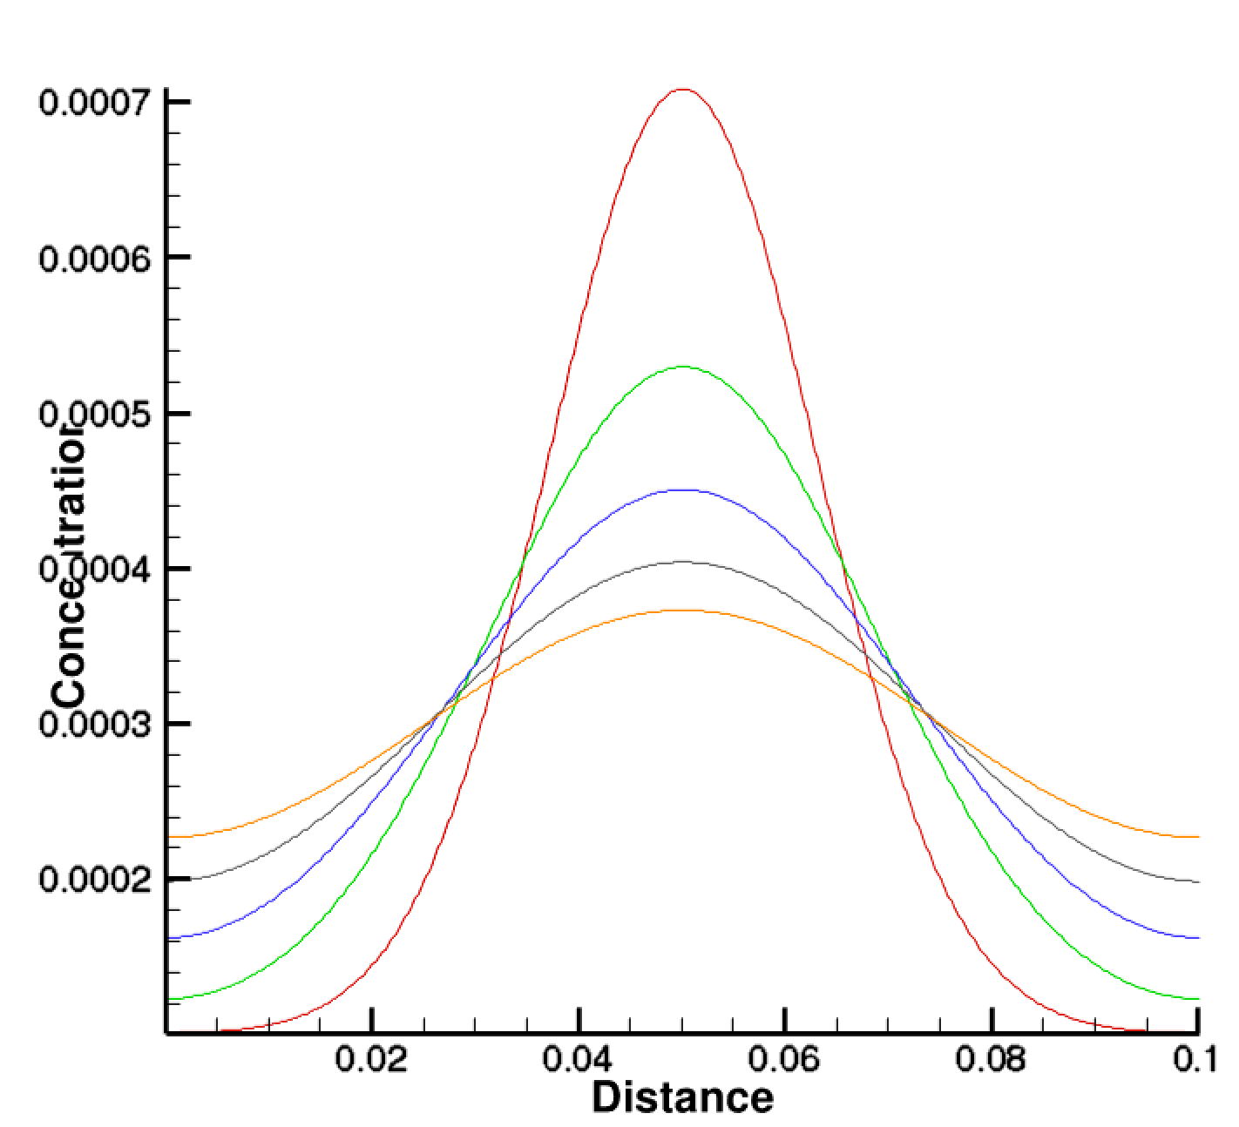
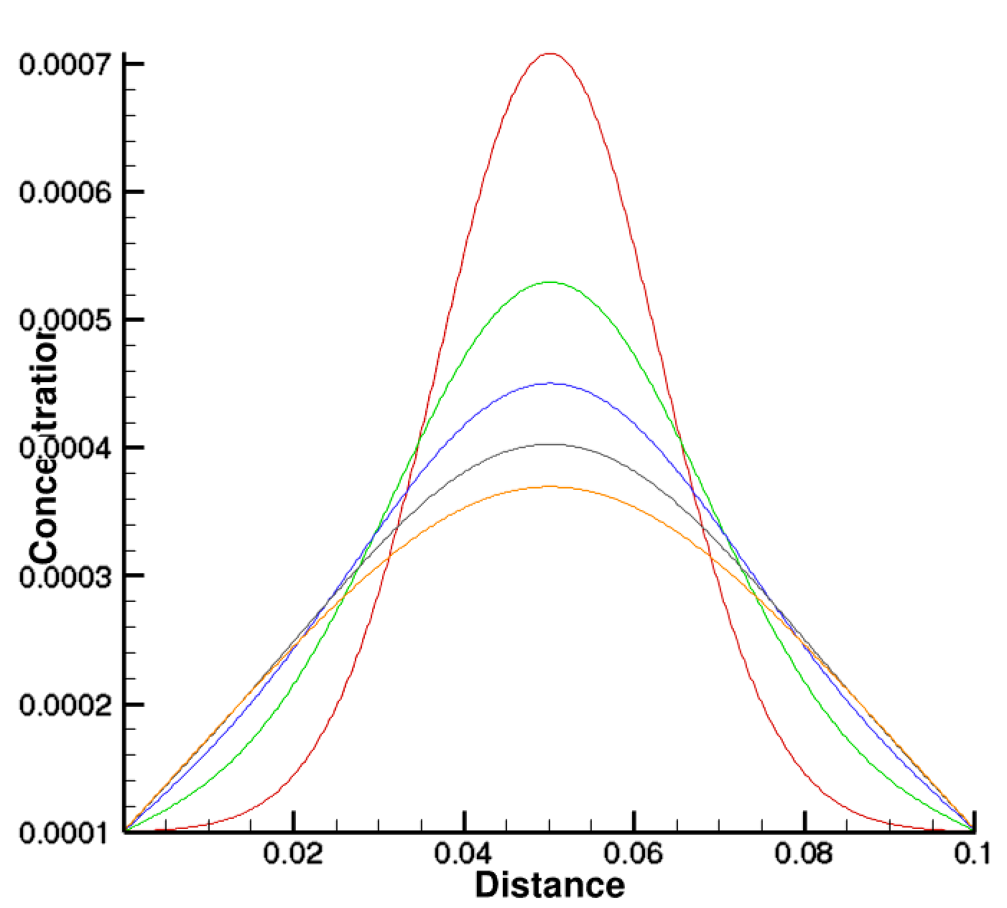
Exercise 3: Fickian Diffusion
Flux boundary
Flux boundary
Dirichlet boundary
Dirichlet boundary
NOTE: Error function analytical (ERF) solution only applies to infinite (or semi-infinite) boundary conditions, so would fail to describe system once mass reaches the boundary

Slide 55
NERNST-PLANCK
MULTICOMPONENT DIFFUSION

Slide 56
Exercise 4: Multicomponent Diffusion
Flux from chemical potential
Fickian
Electrical Potential
Activity Coefficient
Nernst-Planck Equation
Diffusion Potential
Term vanishes if diffusion coefficients are all the same
CrunchTope Equation
Fick’s Law
Diffusion Potential

Slide 57
Exercise 4: Multicomponent Diffusion
(with Nernst-Planck Equation)
BOUNDARY_CONDITIONS
X_begin inlet Dirichlet
X_end initial flux
END
TRANSPORT
distance_units centimeters
time_units seconds
fix_diffusion 1.000e-05
formation_factor 1.0
cementation_exponent 1.0
D_25 H+ 9.312e-05
D_25 Na+ 1.334e-05
D_25 Cl- 2.032E-05
D_25 OH- 5.26e-05
D_25 NO3- 1.00e-05
END
Condition initial
temperature 25.0
pH 4.0
Cl- 1.e-04
Na+ 1.e-04
NO3- 1.e-04
CO2(aq) CO2(g) 1.0E-16
END
Condition inlet
temperature 25.0
pH 6.0
Cl- 1.e-04
Na+ 1.e-04
NO3- 1.e-06
CO2(aq) CO2(g) 1.0E-16
END
Refers to Condition “inlet” and “initial”
Species-specific diffusion coefficients
NOTE: Hydrogen ion will try to diffuse faster than Cl⁻ and Na⁺
TRANSPORT
D_25 H+ 1.000e-05
D_25 Na+ 1.000e-05
D_25 Cl- 1.000e-05
D_25 OH- 1.000e-05
D_25 NO3- 1.000e-05
END
Change diffusion coefficients all to same number and compare results

Slide 58
Exercise 4: Nernst-Planck Equation
Left Boundary
pH 6.0
NO3- 0.001 mM
Cl- 0.1 mM
Na+ 0.1 mM
Initial Condition
pH 4.0
NO3- 0.1 mM
Cl- 0.1 mM
Na+ 0.1 mM
NOTE: No initial gradient in Na⁺ or Cl⁻, so Fick’s Law would say there is no diffusion

Slide 59
Left Boundary
pH 6.0
NO3- 0.001 mM
Cl- 0.1 mM
Na+ 0.1 mM
Initial Condition
pH 4.0
NO3- 0.1 mM
Cl- 0.1 mM
Na+ 0.1 mM

Slide 60
Exercise 4: Nernst-Planck with δ³⁷Cl
Isotopic fractionation expressed in per mil
ISOTOPES
primary 37Cl- Cl- 0.333
END
Rare Isotope
Common Isotope
TRANSPORT
distance_units centimeters
time_units seconds
fix_diffusion 1.000e-05
formation_factor 1.0
cementation_exponent 1.0
D_25 H+ 9.312e-05
D_25 Na+ 1.334e-05
D_25 Cl- 2.032E-05
D_25 37Cl- 2.028E-05
D_25 OH- 5.26e-05
D_25 NO3- 1.00e-05
END
Isotope ratio of standard
Note difference in diffusion coefficients (source of fractionation)
Find isotopic ratios in toperatio_aq1.out

Slide 61
Exercise 4: Nernst-Planck with δ³⁷Cl
Left Boundary
pH 6.0
Cl- 0.075
37Cl- 0.025
Na+ 0.1
NO3- 0.001
D_25 Cl- 2.032E-5
D_25 37Cl- 2.028E-5
Isotope Fractionation
Plot isotopic ratios in toperatio_aq1.out

Slide 62
SORPTION

Slide 63
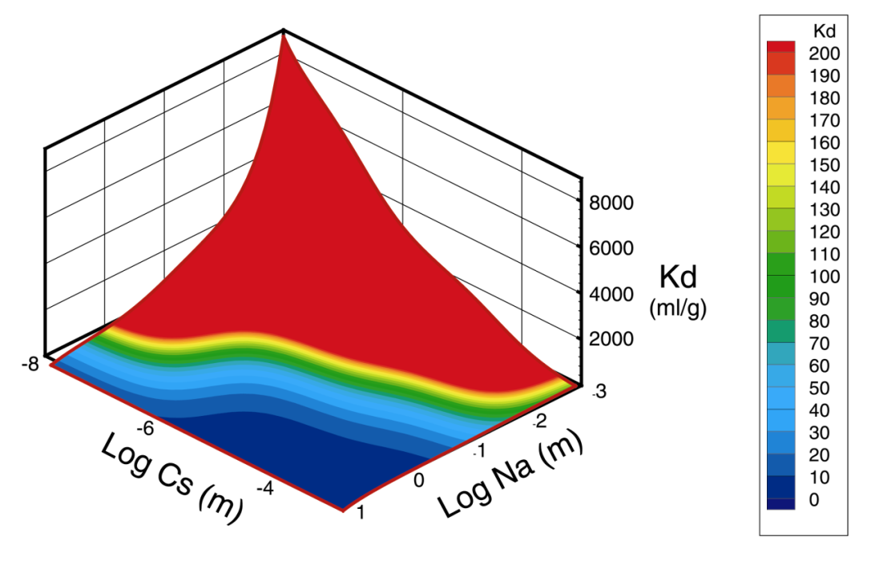
Contaminant Retardation
Contaminant Velocity v_{c}

Slide 64
Exercise 6a: Cesium Ion Exchange
Exchange reaction involving Cs⁺ and a competing Na⁺
Gaines-Thomas convention for activity of an exchange species
Cation charge
Moles/g
Single exchange site
Multiple exchange sites
Cation Exchange Capacity:

Slide 65
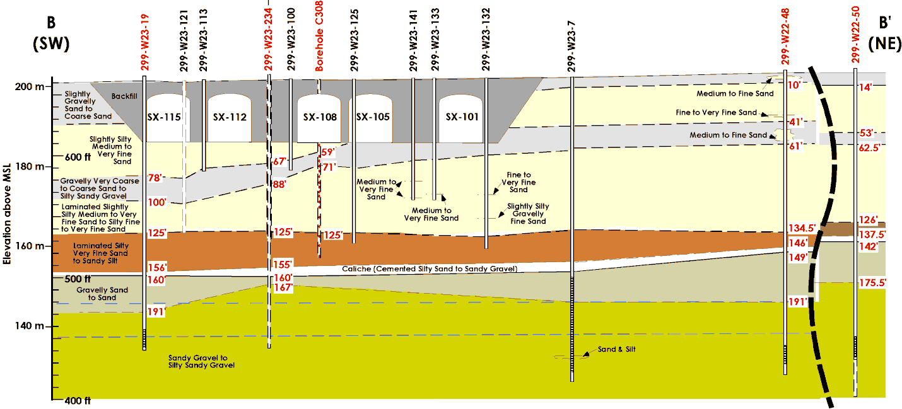
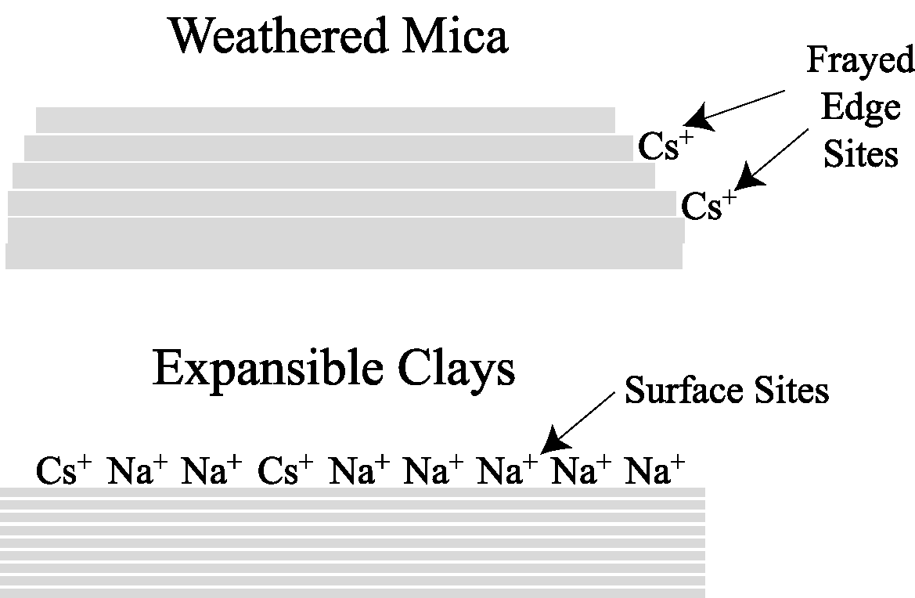
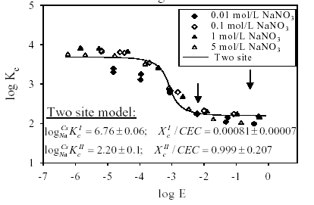
Real World Example for ¹³⁷Cs Cation Exchange
Leaking high ionic strength waste tanks led to contamination of the deep Hanford Vadose Zone
Failure of K_{d} models spawned a major Science and Technology Program at Hanford funded by the U.S. DOE
Binary exchange data from Zachara et al. (2002)

Slide 66
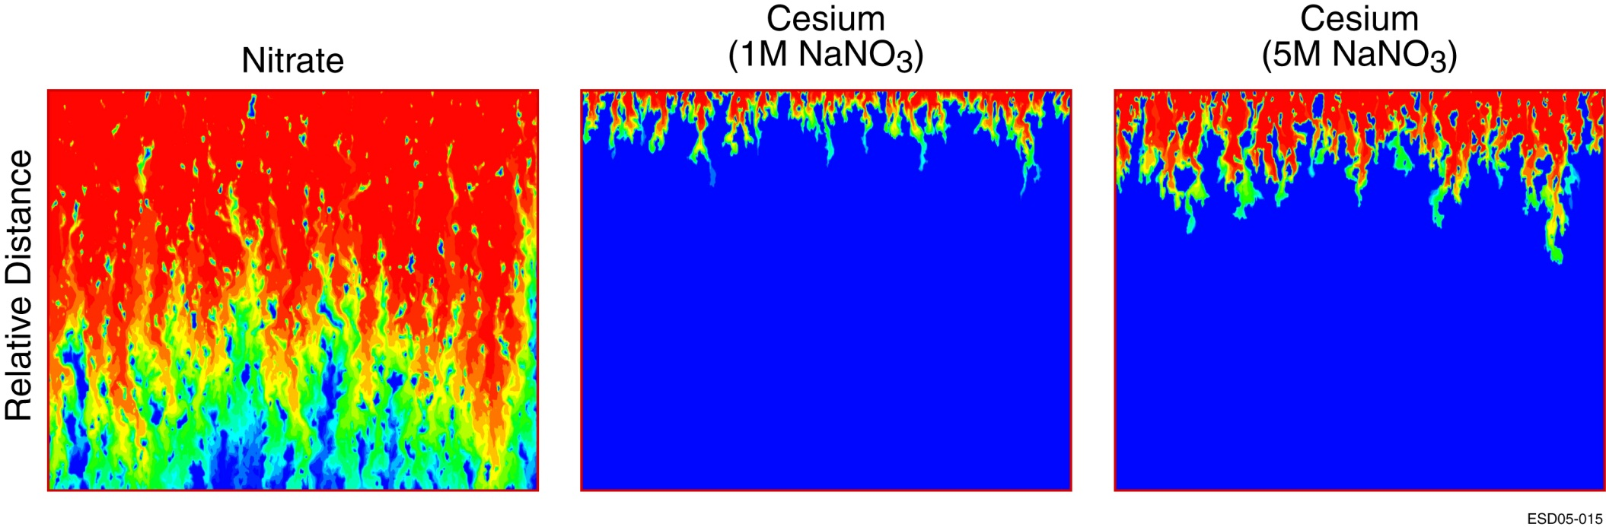
Cs Mobility in High Ionic Strength Solutions
Competitive Effects on Radionuclide So
Greatest mobility of ¹³⁷Cs was below the Hanford SX-108 tank
Steefel et al., 2003; 2005
Cesium K_{d} in Hanford Sediments

Slide 67
Exercise 6a: Cesium Ion Exchange
Simulated sequence:
Input file
HanfordTank-A
HanfordTank-B
HanfordTank-C
NaNO₃ injectate concentration
5 M
5 M
5 M
CsI injectate concentration
0
0.1 mM
0
Duration
19.25 hrs
125 hrs
76.5 hrs
Purpose
Precondition sediment
Active exchange of Cs for Na
Flushing sediment

Slide 68
Exercise 6a: Cesium Ion Exchange
RUNTIME
density_module sodium_nitrate
database HanfordTanksColumnFit3Site-GT.dbs
save_restart Column3NaNO3Flush1.rst
later_inputfiles HanfordTank-B.in HanfordTank-C.in
END
POROSITY
fix_porosity 0.405
porosity_update false
END
ION_EXCHANGE
exchange Xhan1-
exchange Xhan2-
exchange Xhan3-
convention Gaines-Thomas
END
DISCRETIZATION
distance_units centimeters
xzones 100 0.15228
END
3 types of exchange sites
OUTPUT
time_units hours
spatial_profile 19.25
time_series Expt3ColumnFit.out 100
time_series_print Cs+ I-
time_series_output 0.00
END
BOUNDARY_CONDITIONS
x_begin nano3flush flux
x_end initial_condition flux
END
Database entries for log K (selectivity coefficients)
Assumes half-exchange reactions
Frayed edge site on illite
Begin exchange
'NaXhan1' 2 1.0 'Na+' 1.0 'Xhan1-' 7.25224
'NaXhan2' 2 1.0 'Na+' 1.0 'Xhan2-' 4.93359
'NaXhan3' 2 1.0 'Na+' 1.0 'Xhan3-' 1.98868
'CsXhan1' 2 1.0 'Cs+' 1.0 'Xhan1-' 0.00
'CsXhan2' 2 1.0 'Cs+' 1.0 'Xhan2-' 0.00
'CsXhan3' 2 1.0 'Cs+' 1.0 'Xhan3-' 0.00
Planar sites on illite

Slide 69
Exercise 6a: Cesium Ion Exchange
Initial Condition
Sodium Nitrate Flush
Condition initial_condition
units molar
temperature 25.0
pH 8.0
HCO3- CO2(g) 3.15e-04
K+ 0.0015
NO3- 0.001
Cs+ 0.000
I- 0.000
Na+ 0.001
Ca++ Calcite
Mg++ 0.00005
Tracer 0.0
Cl- charge
Xhan1- -cec 2.277023E-08
Xhan2- -cec 2.621486E-07
Xhan3- -cec 1.20E-04
Calcite 0.01 specific_surface_area 0.1
SolidDensity -ss_ratio 4698
END
Condition nano3flush
units molar
temperature 25.0
pH 8.0
HCO3- CO2(g) 3.15e-04
K+ 1.e-5
Cs+ 0.0
I- 0.0
Na+ 1.00
NO3- 1.00
Ca++ 0.0
Mg++ 0.0
Tracer 0.001
Cl- 0.0
Xhan1- -cec 2.277023E-08
Xhan2- -cec 2.621486E-07
Xhan3- -cec 1.20E-04
Calcite 0.01 specific_surface_area 0.1
SolidDensity -ss_ratio 4698
END
Frayed edge site on illite
(eq/g)
Planar sites on illite (eq/g)
FLOW
time_units years
distance_units meters
constant_flow 638.2
END
BOUNDARY_CONDITIONS
x_begin nano3flush flux
x_end initial_condition flux
END

Slide 70
Exercise 6a: Cesium Ion Exchange
Cesium Spike: HanfordTank-B.in
Sodium Nitrate Flush: HanfordTank-C.in
Condition cesiumflush
units molar
temperature 25.0
pH 8.0
HCO3- CO2(g) 3.15e-04
K+ 1.e-5
Cs+ 1.05e-4
I- 1.05e-4
Na+ 1.00
NO3- 1.00
Ca++ 0.000
Mg++ 0.0
Tracer 0.001
Cl- 0.0
Xhan1- -cec 2.277023E-08
Xhan2- -cec 2.621486E-07
Xhan3- -cec 1.20E-04
Calcite 0.01 specific_surface_area 0.1
SolidDensity -ss_ratio 4698
END
Condition nano3flush
units molar
temperature 25.0
pH 8.0
HCO3- CO2(g) 3.15e-04
K+ 1.e-5
Cs+ 0.0
I- 0.0
Na+ 1.00
NO3- 1.00
Ca++ 0.0
Mg++ 0.0
Tracer 0.001
Cl- 0.0
Xhan1- -cec 2.277023E-08
Xhan2- -cec 2.621486E-07
Xhan3- -cec 1.20E-04
Calcite 0.01 specific_surface_area 0.1
SolidDensity -ss_ratio 4698
END
This run “inherits” NaNO3 exchanged sediment from HanfordTank-A run
This run “inherits” Cs contaminated sediment from HanfordTank-B run
BOUNDARY_CONDITIONS
x_begin cesiumflush flux
x_end initial_condition flux
END
BOUNDARY_CONDITIONS
x_begin nano3flush flux
x_end initial_condition flux
END

Slide 71
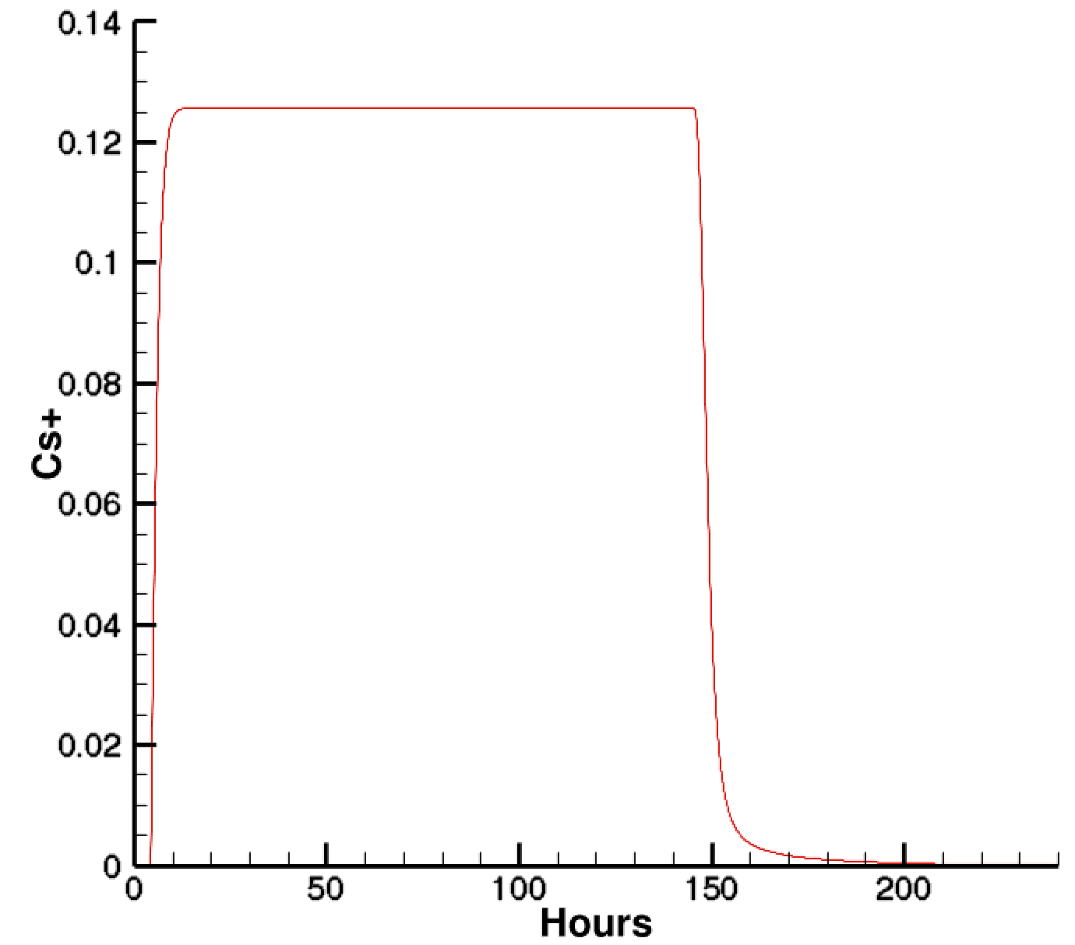
Exercise 6a: Cesium Ion Exchange
Cs spike stops here, only NaNO3 flush
Column
effluent breakthrough curve
Cs spike starts here
Cs desorption

Slide 72
Exercise 6b: Surface Complexation
Surface Hydroxyl
Protonation-deprotonation reactions controlling surface charge
First Acidity Constant
Second Acidity Constant
Electrostatic Effects
Surface charge density

Slide 73
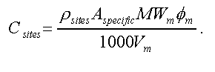
Exercise 6b: Surface Complexation
Surface Complexation of Zn⁺² on Fe(OH)₃
!!!Site name <site density mol/m**2>
>FeOH_weak 3.703704E-06
>FeOH_strong 9.259259E-08
Fe(OH)3 2.943109E-05 specific_surface_area 600.0
!!! Note: Gives 0.09 g/kgw water Fe(OH)3, 54 m**2 surface
Exercise will “sweep” the pH from 5.0 to 8.0 to show the Zn “pH edge”

Slide 74
Exercise 6b: Surface Complexation
OUTPUT
time_units days
spatial_profile 365
time_series_at_node PHREEQCexample8.out 1 1 1
SURFACE_COMPLEXATION
>FeOH_strong on Fe(OH)3
>FeOH_weak on Fe(OH)3
END
Condition Solution1
temperature 25.0
pH 5.00
Zn++ 1.E-07 equilibrate_surface
Na+ charge
NO3- 1.0000E-01
Fe+++ 0.00
O2(aq) 2.4647E-04
!Site name <site density mol/m**2>
>FeOH_weak 3.703704E-06
>FeOH_strong 9.259259E-08
Fe(OH)3 2.943109E-05 specific_surface_area 600.0
SolidDensity 2600.0
!! Note: Gives 0.09 g/kgw water Fe(OH)3, 54 m**2 surface
!! Based on a density of 1017 kg/m**3, 1.017 g/cm**3
!! Volume Fraction Fe(OH)3 [m**3/m**3]*0.001*Molecular Weight Fe(OH)3/(Porosity*Molar Volume Fe(OH)3 [m**3/mole]) = g/L, but we want g/kg water, so g/L * (1/ro) = g/kgw
END
Partitions total concentration between surface and aqueous
Site densities for weak and strong sites

Slide 75
CO₂ ATTACK ON CEMENT

Slide 76
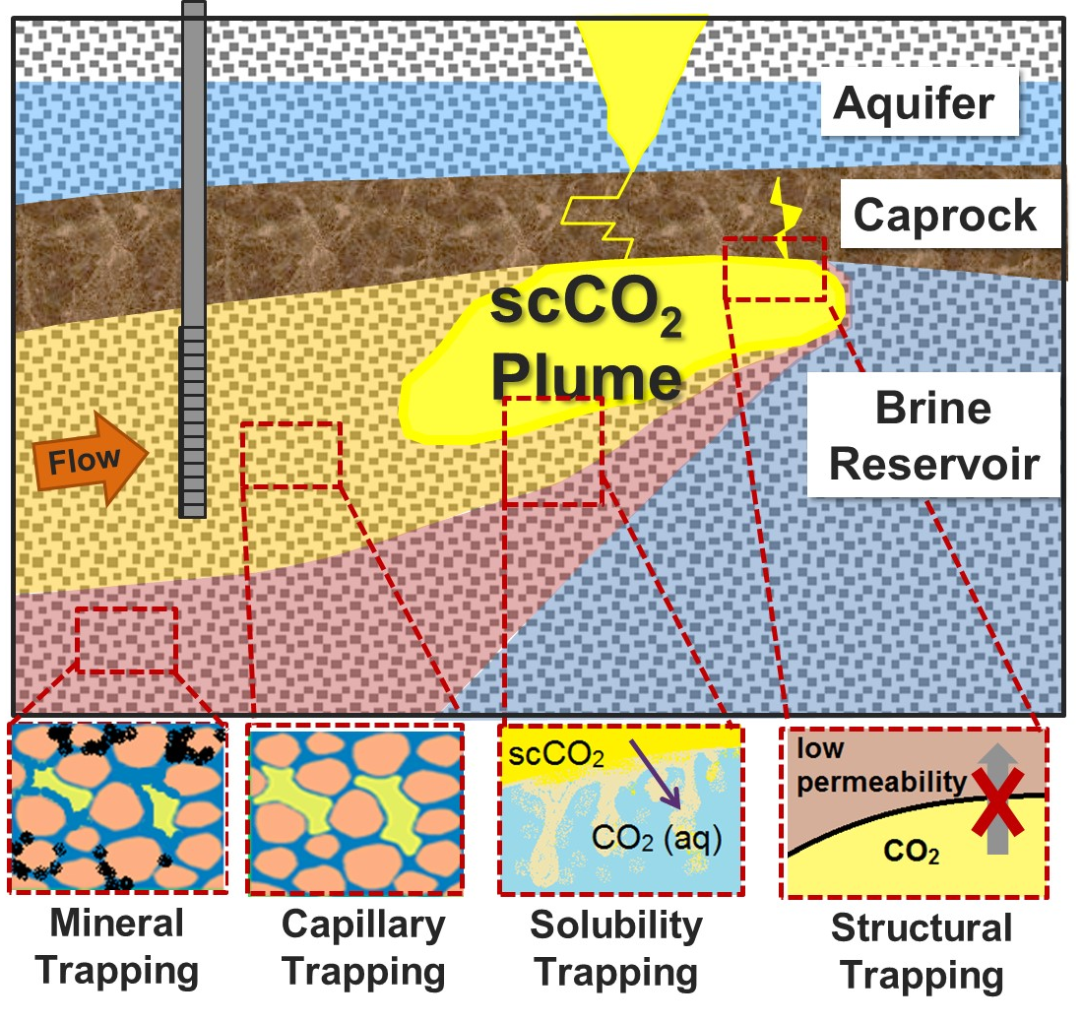
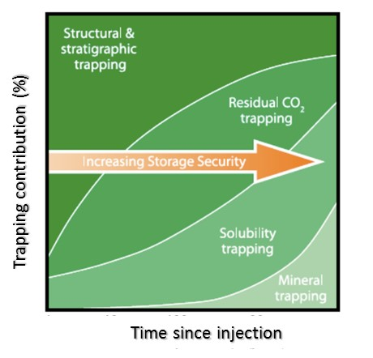
Exercise 7: CO₂ Attack on Cement
Diffusion-Reaction System
Dirichlet Boundary: Supercritical CO₂ at 100 bars
No flux
Mineralogy:
Portlandite
Calcium-silica hydrate (CSH)
Calcite precipitates
Li, Steefel, & Jun, 2017

Slide 77
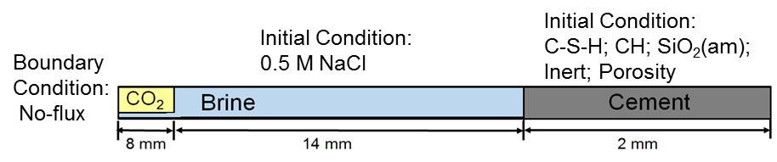
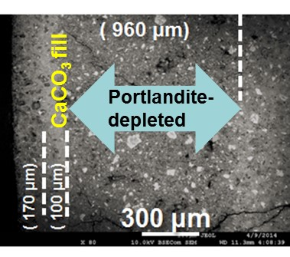
Exercise 7: CO₂ Attack on Cement
Super-critical CO₂
Cement
Based on:
Li, Q., C.I. Steefel, Y-S Jun (2017) Deciphering calcium carbonate precipitation associated with CO₂ attack on cement using reactive transport modeling. Environmental Science and Technology 51: 10861-10871, doi: 10.1021/acs.est.7b00594.

Slide 78
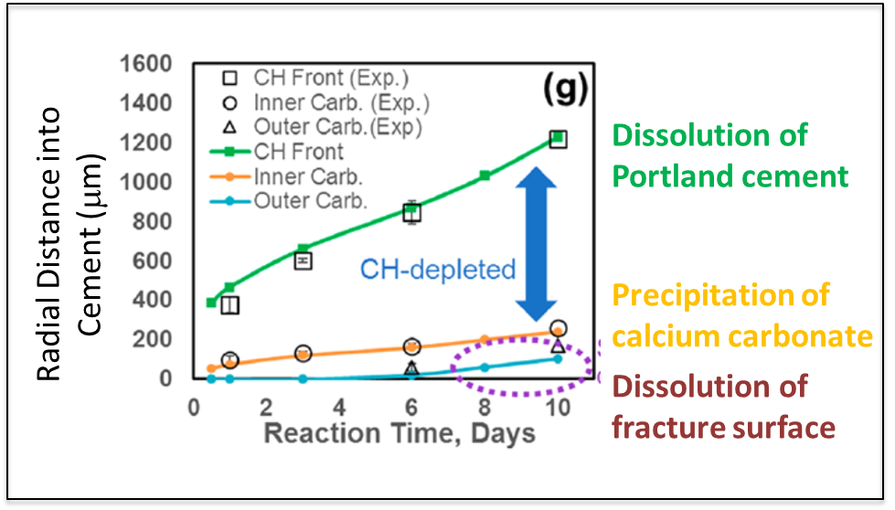
Exercise 7: CO₂ Attack on Cement
Li, Q., C.I. Steefel, Y-S Jun (2017) Deciphering calcium carbonate precipitation associated with CO₂ attack on cement using reactive transport modeling. Environmental Science and Technology 51: 10861-10871, doi: 10.1021/acs.est.7b00594.

Slide 79
Exercise 7: CO₂ Attack on Cement
RUNTIME
!!!fix_saturation 0.999
read_saturationfile QL_Saturation.dat
Duan true
Qingyun true
NUCLEATION
&Nucleation
NameMineral = Calcite
label = nucleatecalcite
A_zero25C = 0.00000001
B_nucleation = 0.000905
Sigma_mJm2 = 47
SSA_m2g = 1
Surface = Bogusite_i
/
END
NUCLEATION
&Nucleation
NameMineral = SiO2(am)
label = nucleateSiO2(am)
A_zero25C = 0.00000001
B_nucleation = 0.000905
Sigma_mJm2 = 20000
SSA_m2g = 1
Surface = Bogusite_i
/
END
Pre-exponential J₀
Constant terms
POROSITY
porosity_update true
minimum_porosity 0.015
porosity_exponent 3.00
porosity_threshold 0.017
END
Interfacial free energy
Specific surface area of nucleated phase
Template for nucleation
Calcite -label nucleatecalcite
Calcite -label h+ -rate -3.0
Calcite_mix -label h+ -rate -3.0
SiO2(ammix) -label default -rate -6.5
SiO2(am) -label default -rate -6.5
SiO2(am) -label nucleateSiO2(am)
Portlandite -label default -rate -5.0
CSH(1.6) -label default -rate -7.8
CSH(0.8) -label default -rate -7.8
Bogusite -rate -35.00
Bogusite_i -rate -35.00
Two calcites with slightly different solubility

Slide 80
Exercise 7: CO₂ Attack on Cement
Condition Brine-Seed
!!Solution w/o minerals
temperature 95.0
units mol/kg
pH charge
CO2(aq) CO2(g) 100.0
Ca++ 0.0
SiO2(aq) 0.000001
SO4-- 0.0
Na+ 0.5
Cl- 0.50064
Calcite 0.0 ssa 1
Calcite_mix 0.0 ssa 1
SiO2(am) 0.0 ssa 1
SiO2(ammix) 0.0 ssa 1
CSH(1.6) 0.0
CSH(0.8) 0.0
Portlandite 0.0
Bogusite 0.0 0.0
Bogusite_i 0.01 ssa 1
set_porosity 16
!!set_saturation 0.95
Condition Cement
temperature 95.0
pH Portlandite
CO2(aq) 1.E-10
Ca++ 0.001
Na+ charge
Cl- 0.500
SiO2(aq) 0.0000001
Calcite_mix 0.00001 ssa 1
CSH(1.6) 0.31 ssa 1
CSH(0.8) 0.05 ssa 1
SiO2(ammix) 0.01 ssa 1
Portlandite 0.16 ssa 1
Bogusite 0.27 0.0
set_porosity 0.20
!!set_saturation 1
END
INITIAL_CONDITIONS
Brine 1-324
CO2 1-4
Brine-Seed 210-310
Cement 325-524
END
DISCRETIZATION
distance_units microns
xzones 4 2000 320 100 200 10
END
Li et al, 2017

Slide 81
Exercise 7: CO₂ Attack on Cement
Reactive Surface Area Options
Condition Cement
temperature 95.0
pH Portlandite
CO2(aq) 1.E-10
Ca++ 0.001
Na+ charge
Cl- 0.500
SiO2(aq) 0.0000001
Calcite 0.00001 ssa 1
CSH(1.6) 0.35 ssa 1
SiO2(am) 0.10 ssa 1
Portlandite 0.20 ssa 0.01
Bogusite 0.20 1.0
Teflon 0.0 1.0
set_porosity 0.15
END
Specific Surface Area (m²/g)
Bulk Surface Area (m²/m³)
1.0000000e-01
1.0000000e-01
1.0000000e-01
1.0000000e-01
1.0000000e+00
1.0000000e+00
RUNTIME
time_units days
!!fix_saturation 0.999
read_saturationfile QL-saturation.dat
1st four grid cells are unsaturated (10%)

Slide 82
Exercise 7: CO₂ Attack on Cement
Li et al, ES&T, 2017

Slide 83
ISOTOPIC FRACTIONATION

Slide 84
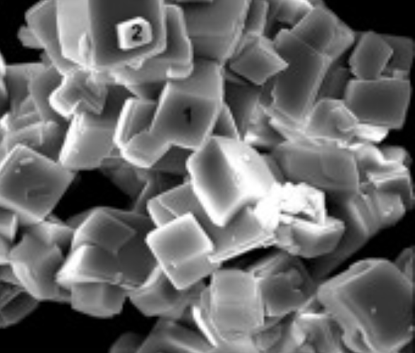
Exercise 8: Calcite precipitation with δ⁴⁴Ca
Fluid
Solid
Gebrehiwet et al., 2012
20 μm

Slide 85
Exercise 8: Calcite precipitation with δ⁴⁴Ca
Isotope activities based on mole fractions
Steefel et al. 2014

Slide 86
Exercise 8: Calcite precipitation with δ⁴⁴Ca
INITIAL_CONDITIONS
amendment 1-1 1-1 1-1
END
DISCRETIZATION
distance_units centimeters
xzones 1 1.0
END
MINERALS
CalciteRifle -label default -rate -4.10000000
!!! 2 per mil kinetic fractionation
Calcite44Rifle -label default -rate -4.10217692
END
ISOTOPES
primary Ca44++ Ca++ 0.021667
mineral Calcite44Rifle CalciteRifle bulk
isotope_time_series BatchExperiment.out 1 1 1
END
Kinetic fractionation
Isotope Standard
condition amendment
units mmol/kg
temperature 25.0
H+ 0.11544
Ca++ 5.28
Ca44++ 0.111997921
HCO3- 10.0
!! Mineral name <volume fraction m3/m3>
CalciteRifle 0.7833831 bsa 1.33E-02
Calcite44Rifle 0.0166170 bsa 1.33E-02
END
Isotopic back-reaction with
Bulk
Surface
None
Output isotope time series to file at grid cell

Slide 87
Exercise 8: Calcite precipitation with δ⁴⁴Ca
Steefel et al. 2014

Slide 88
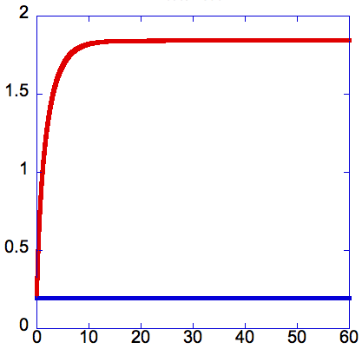
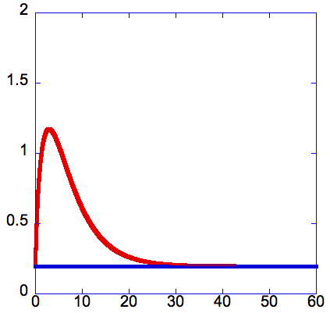

Exercise 8: Calcite precipitation with δ⁴⁴Ca
“None”
“Bulk”
“Surface”
(1) Isotopically irreversible
(2) In equilibrium with bulk
(3) In equilibrium with surface
fluid
δ⁴⁴Ca (‰)
δ⁴⁴Ca (‰)
δ⁴⁴Ca (‰)
fluid
fluid
bulk mineral
bulk mineral
bulk mineral
days
days
days
Steefel et al. 2014

Slide 89

Exercise 9: Microbial Redox
Dual Monod
E = electron acceptor
D = electron donor
Druhan, Steefel, and others 2014

Slide 90


Exercise 9: Microbial Redox
Rifle Sediment
Acetate & Sulfate (mM)
CH₃COO⁻_{(aq)}
+ Rifle groundwater:
Uranium | 0.7 – 1.5 μM
pH | 7.0 – 7.2
Alkalinity | 7 – 10 meq/L
Eh | -150 to 240 mV
DO | 3 – 20 μM
Fe(II) | 15 – 50 μM
Nitrate | 2 – 3 μM
Sulfate | 8 – 11 mM
Sulfide | 0.03 – 0.5 μM
Fe⁺⁺_{(aq)} & HS⁻ (μM)
Druhan et al., 2014
Days

Slide 91





Exercise 9: Microbial Redox
10 cm
50 cm
90 cm
[SO₄²⁻]
Sulfate (mM)
Sulfate (mM)
Sulfate (mM)
δ³⁴S (‰)
δ³⁴S (‰)
δ³⁴S (‰)
δ³⁴S
30 cm
70 cm
day
Sulfate (mM)
Sulfate (mM)
δ³⁴S (‰)
δ³⁴S (‰)
day
day
Druhan et al., 2014

Slide 92
POROSITY-PERMEABILITY CHANGE

Slide 93
Exercise 10: Porosity-Permeability
Xie, M., Mayer, K.U., Claret, F., Alt-Epping, P., Diederik, J., Steefel, C.I., Chiaberge, C., Simunek, J. (2015) Implementation and evaluation of permeability-porosity and tortuosity-porosity relationships linked to mineral dissolution-precipitation. Computational Geosciences 19: 655-671. DOI 10.1007/s10596-014-9458-3

Slide 94
Exercise 10: Porosity-Permeability
Condition mingliang_boundary
temperature 25.0
pH 3.0
Ca++ 0.0001
CO3-- 0.01
SO4-- 0.1
Fe++ 0.000223
!!Fe++ 8.0e-3
Fe+++ 0.0143
Al+++ 0.0143
K+ 7.67e-5
O2(aq) O2(g) 0.1005
Na+ 9.092e-2
Tracer 0.01
Calcite 0.30 1.00
Gypsum 0.00 1.00
Ferrihydrite 0.00 1.00
Jarosite 0.00 1.00
Gibbsite 0.05 1.00
Siderite 0.05 1.00
TracerMineral 0.35 1.00
END
Condition initial
temperature 25.0
pH 7.0
Ca++ charge
!!Ca++ 1.69512E-04
CO3-- CO2(g) 0.01
SO4-- 1.69512E-04
Fe++ 1.0e-5
Fe+++ 1.0e-10
Al+++ 1.0e-5
K+ 1.0e-5
O2(aq) O2(g) 1.E-15
Na+ 1.0e-15
Tracer 0.00001
Calcite 0.22 1.00
Gypsum 0.00 1.00
Ferrihydrite 0.00 1.00
Jarosite 0.00 1.00
Gibbsite 0.05 1.00
Siderite 0.05 1.00
TracerMineral 0.33 1.00
END

Slide 95
Exercise 10: 2D Porosity-Permeability
FLOW
distance_units meters
time_units second
calculate_flow true
read_PermeabilityFile perm5_2D.hyc SingleFile3D
!!IF homogeneous flow:
!!permeability_x 1.18602E-11 default
!!permeability_x 2.61491E-10 zone 0-0 1-40 1-1
!!permeability_x 2.61491E-10 zone 31-31 1-40 1-1
permeability_y 0.00 zone 1-31 42-42 1-1
permeability_y 0.00 zone 1-31 0-0 1-1
pressure 30 default
pressure 104.4365949 zone 0-0 1-41 1-1 fix
pressure 0.0 zone 32-32 1-41 1-1 fix
gravity 90.0 90.0 90.0
END
DISCRETIZATION
distance_units meters
xzones 1 0.050 29 0.10 1 0.050
yzones 1 0.025 39 0.05 1 0.025
END
MINERALS
!! Standard linear TST calcite
Calcite -label default -rate -4.301029996
Gypsum -label default -rate -4.301029996
Ferrihydrite -label default -rate -5.301029996
Jarosite -label default -rate -5.301029996
Gibbsite -label default -rate -6.301029996
Siderite -label default -rate -5.301029996
TracerMineral -label default -rate -35.00
END

Slide 96
Exercise 10: 1D Porosity-Permeability
Xie et al, 2015

Slide 97

Exercise 10: 2D Porosity-Permeability
Initial Permeability
Porosity update:
Permeability update:
Xie et al., 2015

Slide 98

Exercise 10: 2D Porosity-Permeability
Calcite at 300 years
Xie et al., 2014

Slide 99

Exercise 10: 2D Porosity-Permeability
Gypsum at 300 years
Xie et al., 2015

Slide 100

Exercise 10: 2D Porosity-Permeability
Porosity at 300 years
Xie et al., 2015

Slide 101
DIFFUSION IN CLAY

Slide 102

Exercise 11: Diffusion in Clay
Experimental setup
High concentration reservoir
Low concentration reservoir

Slide 103
Example of results
Data from Tachi & Yotsuji, 2014

Slide 104


$${Flux}_{outlet}={\left.\frac{∂C}{∂t}\right|}_{outlet}×\frac{V_{outlet}}{S_{outlet}}$$
mol m⁻² s⁻¹
$${Flux}_{norm,outlet}=\frac{{Flux}_{outlet}}{C_{inlet}}$$
m s⁻¹
Data from Tinnacher et al. GCA, 2016

Slide 105
Geometry of the system, general properties
DISCRETIZATION
distance_units meters
xzones 1 0.0001 50 0.0001 1 0.0001
yzones 1 100
zzones 1 1
END
INITIAL_CONDITIONS
HReservoir 1-1 1-1 1-1
Clay 2-51 1-1 1-1
LReservoir 52-52 1-1 1-1
END
Only one grid cell for the reservoir; large volume = 10 L
BOUNDARY_CONDITIONS
X_begin HReservoir Flux
X_end Lreservoir Flux
END
FLOW
space_units meters !!Default : meters ; km, cm, mm, um
time_units seconds !!Default : years ; days, hours, minutes, seconds
constant_flow 0.0 0.0 !!Default : 0.0
END
closed closed boundary conditions, only diffusion

Slide 106
Geometry of the system, general properties
POROSITY
fix_porosity 0.5
fix_microporosity 0.5
UpdateDDL false
MultiplyPorosityTortuosity true
END
New keywords that are specific to CrunchClay (ignored in CrunchTope)
TRANSPORT
distance_units meters
time_units second
fix_diffusion 1e-9
D_25 H+ 9.31e-9
D_25 Bogus 1e-20
D_25 OH- 5.27e-9
D_25 Na+ 1.3e-9
…
D_MP H+ 9.31e-9
D_MP Bogus 1e-20
D_MP OH- 5.27e-9
D_MP Na+ 1.3e-9
…
tortuosity 1 default
tortuosity 1 zone 1-1 1-1 1-1
tortuosity 0.037 zone 2-51 1-1 1-1
tortuosity 1 zone 52-52 1-1 1-1
tortuosityMP 1 default
tortuosityMP 1 zone 1-1 1-1 1-1
tortuosityMP 0.037 zone 2-51 1-1 1-1
tortuosityMP 1 zone 52-52 1-1 1-1
END

Slide 107
Chemistry, surfaces, DL properties
Condition HReservoir
temperature 25.0
units mmol/kg
H2O 55.5
pH 7
Na+ 100
Cl- charge
Br- 1e0
Ca++ 1e0
Hto 1e0
Bogus Bogusite
Bogusite 3.1416e-8 specific_surface_area 750
>montmor- 1e-99 !!site per m2
set_porosity 0.999999999
set_microporosity 1e-10
END
Background electrolyte concentration is high compared to the concentration of the tracers.
Fake mineral with very low solubility that bears the surface
The surface charge is set to zero
Redefinition of the the bulk vs DL porosity for each of the domains
The reservoirs have a porosity value of 1

Slide 108
Chemistry, surfaces, DL properties
Condition Clay
temperature 25.0
units mmol/kg
H2O 55.5
pH 7
Na+ 100
Cl- charge
Br- 1e-27
Ca++ 1e-27
Hto 1e-27
Bogus Bogusite
Bogusite 3.1416e-8 specific_surface_area 750
>montmor- 1.2e-99
set_porosity 5.655e-8
set_microporosity 5.0895e-7
END
Constant background electrolyte concentration
Fake mineral with very low solubility that bears the surface
The surface charge is set to zero
Redefinition of the the bulk vs DL porosity for each of the domains
See explanation in input files for calculation of these values
Here bulk porosity is 10 % of the total porosity

Slide 109

Results
Concentration in the outlet reservoir
Why do the Br and HTO concentrations increase faster than the Ca concentration?

Slide 110

Results
Increase the surface charge in the clay plug to 0.9 mol charge/kg clay
What is the species that diffuse the fastest now ?

Slide 111
Results
Add surface complexation reactions:
>montmor- + Na+ = >montmorNa
2 >montmor- + Ca+2 = > >montmor2Ca
In database:
Begin surface complexation
'>montmorNa' 2 1.0 'Na+' 1.0 '>montmor-' -0.5 -0.5 -0.5 -0.5 -0.5 -0.5 -0.5 -0.5
'>montmor2Ca' 2 1.0 'Ca++' 2.0 '>montmor-' -1 -1 -1 -1 -1 -1 -1 -1
End of surface complexation
Begin surface complexation parameters
>montmor- -1.0
>montmorNa 0.0
>montmor2Ca 0.0
End surface complexation parameters

Slide 112
Results
Add surface complexation reactions:
>montmor- + Na+ = >montmorNa
2 >montmor- + Ca+2 = > >montmor2Ca
The surface charge is partly compensated in the Stern layer (with no diffusion of sorbed species). The remaining charge is compensated in the diffuse layer
No surface complex
With surface complexes
Total Charge in DDL (mol/m^3) = 5.6548800E-04
Total Fixed Charge (mol/m^3) = -5.6548800E-04
Microporosity = 1.470300000000000E-007
DonnanPotential = -9.386105664921650E-002
Total Charge in DDL (mol/m^3) = 2.8973120E-04
Total Fixed Charge (mol/m^3) = -2.8973120E-04
Microporosity = 1.470300000000000E-007
DonnanPotential = -7.672779885055225E-002

Slide 113

Results
Add surface complexation reactions:
What is the effect of Na and Ca surface complexation on Br and Ca diffusion?

Slide 114

Summary

Slide 115
INVERSE MODELING WITH PEST-CRUNCH

Slide 116
Exercise 12: Inverse Modeling with PEST-CrunchTope
Use PEST together with CrunchTope for inverse modeling and sensitivity analysis
http://www.pesthomepage.org/Home.php
PEST

Slide 117
Exercise 12: Inverse Modeling with PEST-CrunchFlow
BatchNoGmin.pst File
pcf
* control data
restart estimation
4 165 1 0 1
1 1 double point 1 0 0
5.0 2.0 0.1 0.005 10
3.0 3.0 0.001
0.01
50 .005 4 4 .010 5
1 1 1
* group definitions and derivative data
all relative 0.01 0.0 switch 1.0 best_fit
* parameter data
k2a none relative 0.20000 -2.0 4.0 all 1.0 0. 1
k2b none relative 0.20000 -2.0 4.0 all 1.0 0. 1
k2c none relative 0.20000 -2.0 4.0 all 1.0 0. 1
k2d none relative 0.20000 -2.0 4.0 all 1.0 0. 1
Number of parameters to be fitted
* observation groups
group_1
* observation data
SrCa-A11 0.00 1 group_1
SrCa-A12 0.00 1 group_1
SrCa-A13 0.00 1 group_1
SrCa-A14 42.37 1 group_1
SrCa-A15 0.05 1 group_1
SrCa-A21 1.19 1 group_1
SrCa-A22 0.56 1 group_1
SrCa-A23 0.37 1 group_1
SrCa-A24 40.50 1 group_1
SrCa-A25 0.00 1 group_1
Number of observations
Parameters
* model command line
CrunchTope
* model input/output
datacom-SrExchange.tpl datacom-SrExchange.dbs
PestExchange.ins PestExchange.out
Template file for PEST so it knows where to update parameters in CrunchTope input file
PEST instruction file
Generated by CrunchTope
At command line: i64pest BatchNoGmin.pst

Slide 118
Exercise 12: Inverse Modeling with PEST-CrunchFlow
PestExchange.out File
PestExchange.ins File
Primary Species uEquiv/kgw uEquiv/g solid
Ca++ 3.6555E+01 1.8278E-01
K+ 1.2860E+02 6.4298E-01
Mg++ 9.7581E+00 4.8791E-02
Sr++ 8.2991E+03 4.1495E+01
Na+ 6.0143E+00 3.0071E-02
Primary Species uEquiv/kgw uEquiv/g solid
Ca++ 2.2798E+02 1.1399E+00
K+ 2.0261E+02 1.0131E+00
Mg++ 9.6190E+00 4.8095E-02
Sr++ 8.0784E+03 4.0392E+01
Na+ 1.3673E+00 6.8364E-03
pif @
l2 [srca-a11]34:44
l1 [srca-a12]34:44
l1 [srca-a13]34:44
l1 [srca-a14]34:44
l1 [srca-a15]34:44
l2 [srca-a21]34:44
l1 [srca-a22]34:44
l1 [srca-a23]34:44
l1 [srca-a24]34:44
l1 [srca-a25]34:44
Tells PEST where to find the simulation data in PestExchange.out file to compare to observations
Generated by CrunchTope per instructions in BatchNoGmin.in file
Datacom-SrExchange.tpl File
Datacom-SrExchange.dbs File
'Sr-XB8814-2' 2 1.0 'Sr++' 2.0 'XB8814-2' 0.00 0.000
'Ca-XB8814-2' 2 1.0 'Ca++' 2.0 'XB8814-2' #k2a # 0.000
'Na-XB8814-2' 2 1.0 'Na+' 1.0 'XB8814-2' #k2b # 0.000
'Mg-XB8814-2' 2 1.0 'Mg++' 2.0 'XB8814-2' #k2c # 0.000
'K-XB8814-2' 2 1.0 'K+' 1.0 'XB8814-2' #k2d # 0.000
End of exchange
'Sr-XB8814-2' 2 1.0 'Sr++' 2.0 'XB8814-2' 0.00 0.000
'Ca-XB8814-2' 2 1.0 'Ca++' 2.0 'XB8814-2' .0918334263 0.000
'Na-XB8814-2' 2 1.0 'Na+' 1.0 'XB8814-2' -.909927443 0.000
'Mg-XB8814-2' 2 1.0 'Mg++' 2.0 'XB8814-2' .1465642933 0.000
'K-XB8814-2' 2 1.0 'K+' 1.0 'XB8814-2' -1.88939379 0.000
End of exchange

Slide 119
Exercise 12: Inverse Modeling with PEST-CrunchFlow
BatchNoGmin.rec File
OPTIMISATION RESULTS
Parameters ----->
Parameter Estimated 95% percent confidence limits
value lower limit upper limit
k2a 9.183343E-02 8.310404E-02 0.100563
k2b -0.909927 -1.47566 -0.344194
k2c 0.146564 0.127452 0.165677
k2d -1.88939 -1.96078 -1.81801
Note: confidence limits provide only an indication of parameter uncertainty.
They rely on a linearity assumption which may not extend as far in
parameter space as the confidence limits themselves - see PEST manual.
See file batchnogmin.sen for parameter sensitivities.
Observation Measured Calculated Residual Weight
value value
srca-a11 0.00000 0.182780 -0.182780 1.000
srca-a12 0.00000 0.642980 -0.642980 1.000
srca-a13 0.00000 4.879100E-02 -4.879100E-02 1.000
srca-a14 42.3700 41.4950 0.875000 1.000
srca-a15 5.000000E-02 3.007100E-02 1.992900E-02 1.000
srca-a21 1.19000 1.13990 5.010000E-02 1.000
srca-a22 0.560000 1.01310 -0.453100 1.000
srca-a23 0.370000 4.809500E-02 0.321905 1.000
srca-a24 40.5000 40.3920 0.108000 1.000
srca-a25 0.00000 6.836400E-03 -6.836400E-03 1.000
Find summary of optimization results in *.rec file generated by PEST

Slide 120
Numerical Approach

Slide 121
Derivative of Total Concentration
The derivative of the total concentration with respect to the primary species concentrations
Or using the logarithms of the concentrations as the primary unknowns (which scales the Jacobian matrix, making it numerically more tractable)

Slide 122
Jacobian Matrix for Global Implicit Method
Jx-1
Jx
Jx+1
Jx
Jx-1
Jx+1

Slide 123
Newton’s Method for Global Implicit Method
Nc x Nc Jacobian Submatrix
Nc Residual Vectors

Slide 124
Newton’s Method for Global Implicit
For JX = 2
Nc x Nc
Nc x Nc
Nc x Nc

